Slide 1
ToUpper

Slide 2
ToUpper Constants
  .section .data
  # system call numbers
  .equ SYS_OPEN, 5
  .equ SYS_WRITE, 4
  .equ SYS_READ, 3
  .equ SYS_CLOSE, 6
  .equ SYS_EXIT, 1
  # options for open
  .equ O_RDONLY, 0
  .equ O_CREAT_WRONLY_TRUNC, 03101
  # standard file descriptors
  .equ STDIN, 0
  .equ STDOUT, 1
  .equ STDERROR, 2
  .equ LINUX_SYSCALL, 0x80 # system call interrupt
  .equ END_OF_FILE, 0 # return value of read, meaning we’ve hit end of file
  .equ NUMBER_ARGUMENTS, 2

Slide 3
ToUpper Constants: #define
  .section .data
  # system call numbers
  .equ SYS_OPEN, 5
  .equ SYS_WRITE, 4
  .equ SYS_READ, 3
  .equ SYS_CLOSE, 6
  .equ SYS_EXIT, 1
  # options for open
  .equ O_RDONLY, 0
  .equ O_CREAT_WRONLY_TRUNC, 03101
  # standard file descriptors
  .equ STDIN, 0
  .equ STDOUT, 1
  .equ STDERROR, 2
  .equ LINUX_SYSCALL, 0x80 # system call interrupt
  .equ END_OF_FILE, 0 # return value of read, meaning we’ve hit end of file
  .equ NUMBER_ARGUMENTS, 2
.equ SYS_OPEN, 5
#define SYS_OPEN 5

Slide 4
ToUpper Buffer
  .section .bss
  .equ BUFFER_SIZE, 500 # buffer size = 500 bytes
  .lcomm BUFFER_DATA, BUFFER_SIZE # actual buffer
  .section .text
  # stack positions: where in the stack to find each piece of data
  .equ ST_SIZE_RESERVE, 8 # buffer size
  .equ ST_FD_IN, -4 # input file descriptor
  .equ ST_FD_OUT, -8 # output file descriptor
  .equ ST_ARGC, 0 # number of arguments
  .equ ST_ARGV_0, 4 # name of program
  .equ ST_ARGV_1, 8 # input file name
  .equ ST_ARGV_2, 12 # output file name
  .globl _start
_start:
  ### INITIALIZE PROGRAM ###
  movl %esp, %ebp # save stack pointer
  subl $ST_SIZE_RESERVE, %esp # allocate space on stack
  # for file descriptors

Slide 5
ToUpper Buffer: open input file
  .section .bss
  .equ BUFFER_SIZE, 500 # buffer size = 500 bytes
  .lcomm BUFFER_DATA, BUFFER_SIZE # actual buffer
  .section .text
  # stack positions: where in the stack to find each piece of data
  .equ ST_SIZE_RESERVE, 8 # buffer size
  .equ ST_FD_IN, -4 # input file descriptor
  .equ ST_FD_OUT, -8 # output file descriptor
  .equ ST_ARGC, 0 # number of arguments
  .equ ST_ARGV_0, 4 # name of program
  .equ ST_ARGV_1, 8 # input file name
  .equ ST_ARGV_2, 12 # output file name
  .globl _start
_start:
  ### INITIALIZE PROGRAM ###
  movl %esp, %ebp # save stack pointer
  subl $ST_SIZE_RESERVE, %esp # allocate space on stack
  # for file descriptors
1 open
input file

Slide 6
ToUpper Buffer: open output file
  .section .bss
  .equ BUFFER_SIZE, 500 # buffer size = 500 bytes
  .lcomm BUFFER_DATA, BUFFER_SIZE # actual buffer
  .section .text
  # stack positions: where in the stack to find each piece of data
  .equ ST_SIZE_RESERVE, 8 # buffer size
  .equ ST_FD_IN, -4 # input file descriptor
  .equ ST_FD_OUT, -8 # output file descriptor
  .equ ST_ARGC, 0 # number of arguments
  .equ ST_ARGV_0, 4 # name of program
  .equ ST_ARGV_1, 8 # input file name
  .equ ST_ARGV_2, 12 # output file name
  .globl _start
_start:
  ### INITIALIZE PROGRAM ###
  movl %esp, %ebp # save stack pointer
  subl $ST_SIZE_RESERVE, %esp # allocate space on stack
  # for file descriptors
1 open
2 open
input file
output file

Slide 7
ToUpper Buffer: read into buffer
  .section .bss
  .equ BUFFER_SIZE, 500 # buffer size = 500 bytes
  .lcomm BUFFER_DATA, BUFFER_SIZE # actual buffer
  .section .text
  # stack positions: where in the stack to find each piece of data
  .equ ST_SIZE_RESERVE, 8 # buffer size
  .equ ST_FD_IN, -4 # input file descriptor
  .equ ST_FD_OUT, -8 # output file descriptor
  .equ ST_ARGC, 0 # number of arguments
  .equ ST_ARGV_0, 4 # name of program
  .equ ST_ARGV_1, 8 # input file name
  .equ ST_ARGV_2, 12 # output file name
  .globl _start
_start:
  ### INITIALIZE PROGRAM ###
  movl %esp, %ebp # save stack pointer
  subl $ST_SIZE_RESERVE, %esp # allocate space on stack
  # for file descriptors
1 open
2 open
buffer
input file
output file
500 bytes
500 bytes
3 read into buffer

Slide 8
ToUpper Buffer: read into buffer
  .section .bss
  .equ BUFFER_SIZE, 500 # buffer size = 500 bytes
  .lcomm BUFFER_DATA, BUFFER_SIZE # actual buffer
  .section .text
  # stack positions: where in the stack to find each piece of data
  .equ ST_SIZE_RESERVE, 8 # buffer size
  .equ ST_FD_IN, -4 # input file descriptor
  .equ ST_FD_OUT, -8 # output file descriptor
  .equ ST_ARGC, 0 # number of arguments
  .equ ST_ARGV_0, 4 # name of program
  .equ ST_ARGV_1, 8 # input file name
  .equ ST_ARGV_2, 12 # output file name
  .globl _start
_start:
  ### INITIALIZE PROGRAM ###
  movl %esp, %ebp # save stack pointer
  subl $ST_SIZE_RESERVE, %esp # allocate space on stack
  # for file descriptors
1 open
2 open
buffer
input file
output file
500 bytes
500 bytes
3 read into buffer

Slide 9
ToUpper Buffer: read into buffer
  .section .bss
  .equ BUFFER_SIZE, 500 # buffer size = 500 bytes
  .lcomm BUFFER_DATA, BUFFER_SIZE # actual buffer
  .section .text
  # stack positions: where in the stack to find each piece of data
  .equ ST_SIZE_RESERVE, 8 # buffer size
  .equ ST_FD_IN, -4 # input file descriptor
  .equ ST_FD_OUT, -8 # output file descriptor
  .equ ST_ARGC, 0 # number of arguments
  .equ ST_ARGV_0, 4 # name of program
  .equ ST_ARGV_1, 8 # input file name
  .equ ST_ARGV_2, 12 # output file name
  .globl _start
_start:
  ### INITIALIZE PROGRAM ###
  movl %esp, %ebp # save stack pointer
  subl $ST_SIZE_RESERVE, %esp # allocate space on stack
  # for file descriptors
1 open
2 open
buffer
input file
output file
500 bytes
500 bytes
3 read into buffer

Slide 10
ToUpper Buffer: convert byte
  .section .bss
  .equ BUFFER_SIZE, 500 # buffer size = 500 bytes
  .lcomm BUFFER_DATA, BUFFER_SIZE # actual buffer
  .section .text
  # stack positions: where in the stack to find each piece of data
  .equ ST_SIZE_RESERVE, 8 # buffer size
  .equ ST_FD_IN, -4 # input file descriptor
  .equ ST_FD_OUT, -8 # output file descriptor
  .equ ST_ARGC, 0 # number of arguments
  .equ ST_ARGV_0, 4 # name of program
  .equ ST_ARGV_1, 8 # input file name
  .equ ST_ARGV_2, 12 # output file name
  .globl _start
_start:
  ### INITIALIZE PROGRAM ###
  movl %esp, %ebp # save stack pointer
  subl $ST_SIZE_RESERVE, %esp # allocate space on stack
  # for file descriptors
1 open
4 convert byte
2 open
buffer
input file
output file
500 bytes
500 bytes
3 read into buffer

Slide 11
ToUpper Buffer: convert byte
  .section .bss
  .equ BUFFER_SIZE, 500 # buffer size = 500 bytes
  .lcomm BUFFER_DATA, BUFFER_SIZE # actual buffer
  .section .text
  # stack positions: where in the stack to find each piece of data
  .equ ST_SIZE_RESERVE, 8 # buffer size
  .equ ST_FD_IN, -4 # input file descriptor
  .equ ST_FD_OUT, -8 # output file descriptor
  .equ ST_ARGC, 0 # number of arguments
  .equ ST_ARGV_0, 4 # name of program
  .equ ST_ARGV_1, 8 # input file name
  .equ ST_ARGV_2, 12 # output file name
  .globl _start
_start:
  ### INITIALIZE PROGRAM ###
  movl %esp, %ebp # save stack pointer
  subl $ST_SIZE_RESERVE, %esp # allocate space on stack
  # for file descriptors
1 open
4 convert byte
2 open
buffer
input file
output file
500 bytes
500 bytes
3 read into buffer

Slide 12
ToUpper Buffer: convert byte
  .section .bss
  .equ BUFFER_SIZE, 500 # buffer size = 500 bytes
  .lcomm BUFFER_DATA, BUFFER_SIZE # actual buffer
  .section .text
  # stack positions: where in the stack to find each piece of data
  .equ ST_SIZE_RESERVE, 8 # buffer size
  .equ ST_FD_IN, -4 # input file descriptor
  .equ ST_FD_OUT, -8 # output file descriptor
  .equ ST_ARGC, 0 # number of arguments
  .equ ST_ARGV_0, 4 # name of program
  .equ ST_ARGV_1, 8 # input file name
  .equ ST_ARGV_2, 12 # output file name
  .globl _start
_start:
  ### INITIALIZE PROGRAM ###
  movl %esp, %ebp # save stack pointer
  subl $ST_SIZE_RESERVE, %esp # allocate space on stack
  # for file descriptors
1 open
4 convert byte
2 open
buffer
input file
output file
500 bytes
500 bytes
3 read into buffer

Slide 13
ToUpper Buffer: convert byte
  .section .bss
  .equ BUFFER_SIZE, 500 # buffer size = 500 bytes
  .lcomm BUFFER_DATA, BUFFER_SIZE # actual buffer
  .section .text
  # stack positions: where in the stack to find each piece of data
  .equ ST_SIZE_RESERVE, 8 # buffer size
  .equ ST_FD_IN, -4 # input file descriptor
  .equ ST_FD_OUT, -8 # output file descriptor
  .equ ST_ARGC, 0 # number of arguments
  .equ ST_ARGV_0, 4 # name of program
  .equ ST_ARGV_1, 8 # input file name
  .equ ST_ARGV_2, 12 # output file name
  .globl _start
_start:
  ### INITIALIZE PROGRAM ###
  movl %esp, %ebp # save stack pointer
  subl $ST_SIZE_RESERVE, %esp # allocate space on stack
  # for file descriptors
1 open
4 convert byte
2 open
buffer
input file
output file
500 bytes
500 bytes
3 read into buffer

Slide 14
ToUpper Buffer: read from buffer
  .section .bss
  .equ BUFFER_SIZE, 500 # buffer size = 500 bytes
  .lcomm BUFFER_DATA, BUFFER_SIZE # actual buffer
  .section .text
  # stack positions: where in the stack to find each piece of data
  .equ ST_SIZE_RESERVE, 8 # buffer size
  .equ ST_FD_IN, -4 # input file descriptor
  .equ ST_FD_OUT, -8 # output file descriptor
  .equ ST_ARGC, 0 # number of arguments
  .equ ST_ARGV_0, 4 # name of program
  .equ ST_ARGV_1, 8 # input file name
  .equ ST_ARGV_2, 12 # output file name
  .globl _start
_start:
  ### INITIALIZE PROGRAM ###
  movl %esp, %ebp # save stack pointer
  subl $ST_SIZE_RESERVE, %esp # allocate space on stack
  # for file descriptors
1 open
4 convert byte
2 open
buffer
input file
output file
500 bytes
500 bytes
3 read into buffer
5 read from buffer

Slide 15
ToUpper Buffer: read into buffer
  .section .bss
  .equ BUFFER_SIZE, 500 # buffer size = 500 bytes
  .lcomm BUFFER_DATA, BUFFER_SIZE # actual buffer
  .section .text
  # stack positions: where in the stack to find each piece of data
  .equ ST_SIZE_RESERVE, 8 # buffer size
  .equ ST_FD_IN, -4 # input file descriptor
  .equ ST_FD_OUT, -8 # output file descriptor
  .equ ST_ARGC, 0 # number of arguments
  .equ ST_ARGV_0, 4 # name of program
  .equ ST_ARGV_1, 8 # input file name
  .equ ST_ARGV_2, 12 # output file name
  .globl _start
_start:
  ### INITIALIZE PROGRAM ###
  movl %esp, %ebp # save stack pointer
  subl $ST_SIZE_RESERVE, %esp # allocate space on stack
  # for file descriptors
1 open
2 open
buffer
input file
output file
500 bytes
500 by-
tes
3 read into buffer

Slide 16
ToUpper Buffer: read into buffer
  .section .bss
  .equ BUFFER_SIZE, 500 # buffer size = 500 bytes
  .lcomm BUFFER_DATA, BUFFER_SIZE # actual buffer
  .section .text
  # stack positions: where in the stack to find each piece of data
  .equ ST_SIZE_RESERVE, 8 # buffer size
  .equ ST_FD_IN, -4 # input file descriptor
  .equ ST_FD_OUT, -8 # output file descriptor
  .equ ST_ARGC, 0 # number of arguments
  .equ ST_ARGV_0, 4 # name of program
  .equ ST_ARGV_1, 8 # input file name
  .equ ST_ARGV_2, 12 # output file name
  .globl _start
_start:
  ### INITIALIZE PROGRAM ###
  movl %esp, %ebp # save stack pointer
  subl $ST_SIZE_RESERVE, %esp # allocate space on stack
  # for file descriptors
1 open
2 open
buffer
input file
output file
500 bytes
500 by-
tes
3 read into buffer

Slide 17
ToUpper Buffer: convert byte
  .section .bss
  .equ BUFFER_SIZE, 500 # buffer size = 500 bytes
  .lcomm BUFFER_DATA, BUFFER_SIZE # actual buffer
  .section .text
  # stack positions: where in the stack to find each piece of data
  .equ ST_SIZE_RESERVE, 8 # buffer size
  .equ ST_FD_IN, -4 # input file descriptor
  .equ ST_FD_OUT, -8 # output file descriptor
  .equ ST_ARGC, 0 # number of arguments
  .equ ST_ARGV_0, 4 # name of program
  .equ ST_ARGV_1, 8 # input file name
  .equ ST_ARGV_2, 12 # output file name
  .globl _start
_start:
  ### INITIALIZE PROGRAM ###
  movl %esp, %ebp # save stack pointer
  subl $ST_SIZE_RESERVE, %esp # allocate space on stack
  # for file descriptors
1 open
4 convert byte
2 open
buffer
input file
output file
500 bytes
500 by-
tes
3 read into buffer

Slide 18
ToUpper Buffer: convert byte
  .section .bss
  .equ BUFFER_SIZE, 500 # buffer size = 500 bytes
  .lcomm BUFFER_DATA, BUFFER_SIZE # actual buffer
  .section .text
  # stack positions: where in the stack to find each piece of data
  .equ ST_SIZE_RESERVE, 8 # buffer size
  .equ ST_FD_IN, -4 # input file descriptor
  .equ ST_FD_OUT, -8 # output file descriptor
  .equ ST_ARGC, 0 # number of arguments
  .equ ST_ARGV_0, 4 # name of program
  .equ ST_ARGV_1, 8 # input file name
  .equ ST_ARGV_2, 12 # output file name
  .globl _start
_start:
  ### INITIALIZE PROGRAM ###
  movl %esp, %ebp # save stack pointer
  subl $ST_SIZE_RESERVE, %esp # allocate space on stack
  # for file descriptors
1 open
4 convert byte
2 open
buffer
input file
output file
500 bytes
500 by-
tes
3 read into buffer
5 read from buffer

Slide 19
ToUpper Buffer: convert byte
  .section .bss
  .equ BUFFER_SIZE, 500 # buffer size = 500 bytes
  .lcomm BUFFER_DATA, BUFFER_SIZE # actual buffer
  .section .text
  # stack positions: where in the stack to find each piece of data
  .equ ST_SIZE_RESERVE, 8 # buffer size
  .equ ST_FD_IN, -4 # input file descriptor
  .equ ST_FD_OUT, -8 # output file descriptor
  .equ ST_ARGC, 0 # number of arguments
  .equ ST_ARGV_0, 4 # name of program
  .equ ST_ARGV_1, 8 # input file name
  .equ ST_ARGV_2, 12 # output file name
  .globl _start
_start:
  ### INITIALIZE PROGRAM ###
  movl %esp, %ebp # save stack pointer
  subl $ST_SIZE_RESERVE, %esp # allocate space on stack
  # for file descriptors
1 open
4 convert byte
2 open
buffer
input file
output file
500 bytes
500 by-
tes
3 read into buffer

Slide 20
ToUpper Buffer: read from buffer
  .section .bss
  .equ BUFFER_SIZE, 500 # buffer size = 500 bytes
  .lcomm BUFFER_DATA, BUFFER_SIZE # actual buffer
  .section .text
  # stack positions: where in the stack to find each piece of data
  .equ ST_SIZE_RESERVE, 8 # buffer size
  .equ ST_FD_IN, -4 # input file descriptor
  .equ ST_FD_OUT, -8 # output file descriptor
  .equ ST_ARGC, 0 # number of arguments
  .equ ST_ARGV_0, 4 # name of program
  .equ ST_ARGV_1, 8 # input file name
  .equ ST_ARGV_2, 12 # output file name
  .globl _start
_start:
  ### INITIALIZE PROGRAM ###
  movl %esp, %ebp # save stack pointer
  subl $ST_SIZE_RESERVE, %esp # allocate space on stack
  # for file descriptors
1 open
4 convert byte
2 open
buffer
input file
output file
500 bytes
500 by-
tes
3 read into buffer
5 read from buffer

Slide 21
ToUpper Buffer: read into buffer
  .section .bss
  .equ BUFFER_SIZE, 500 # buffer size = 500 bytes
  .lcomm BUFFER_DATA, BUFFER_SIZE # actual buffer
  .section .text
  # stack positions: where in the stack to find each piece of data
  .equ ST_SIZE_RESERVE, 8 # buffer size
  .equ ST_FD_IN, -4 # input file descriptor
  .equ ST_FD_OUT, -8 # output file descriptor
  .equ ST_ARGC, 0 # number of arguments
  .equ ST_ARGV_0, 4 # name of program
  .equ ST_ARGV_1, 8 # input file name
  .equ ST_ARGV_2, 12 # output file name
  .globl _start
_start:
  ### INITIALIZE PROGRAM ###
  movl %esp, %ebp # save stack pointer
  subl $ST_SIZE_RESERVE, %esp # allocate space on stack
  # for file descriptors
1 open
2 open
buffer
input file
output file
500 bytes
3 read into buffer

Slide 22
ToUpper Buffer: read from buffer
  .section .bss
  .equ BUFFER_SIZE, 500 # buffer size = 500 bytes
  .lcomm BUFFER_DATA, BUFFER_SIZE # actual buffer
  .section .text
  # stack positions: where in the stack to find each piece of data
  .equ ST_SIZE_RESERVE, 8 # buffer size
  .equ ST_FD_IN, -4 # input file descriptor
  .equ ST_FD_OUT, -8 # output file descriptor
  .equ ST_ARGC, 0 # number of arguments
  .equ ST_ARGV_0, 4 # name of program
  .equ ST_ARGV_1, 8 # input file name
  .equ ST_ARGV_2, 12 # output file name
  .globl _start
_start:
  ### INITIALIZE PROGRAM ###
  movl %esp, %ebp # save stack pointer
  subl $ST_SIZE_RESERVE, %esp # allocate space on stack
  # for file descriptors
1 open
4 convert byte
2 open
buffer
input file
output file
500 bytes
3 read into buffer
5 read from buffer

Slide 23
ToUpper Buffer: etc.
  .section .bss
  .equ BUFFER_SIZE, 500 # buffer size = 500 bytes
  .lcomm BUFFER_DATA, BUFFER_SIZE # actual buffer
  .section .text
  # stack positions: where in the stack to find each piece of data
  .equ ST_SIZE_RESERVE, 8 # buffer size
  .equ ST_FD_IN, -4 # input file descriptor
  .equ ST_FD_OUT, -8 # output file descriptor
  .equ ST_ARGC, 0 # number of arguments
  .equ ST_ARGV_0, 4 # name of program
  .equ ST_ARGV_1, 8 # input file name
  .equ ST_ARGV_2, 12 # output file name
  .globl _start
_start:
  ### INITIALIZE PROGRAM ###
  movl %esp, %ebp # save stack pointer
  subl $ST_SIZE_RESERVE, %esp # allocate space on stack
  # for file descriptors
1 open
4 convert byte
2 open
buffer
input file
output file
500 bytes
etc…
3 read into buffer
etc…
5 read from buffer

Slide 24
ToUpper Buffer: EOF
  .section .bss
  .equ BUFFER_SIZE, 500 # buffer size = 500 bytes
  .lcomm BUFFER_DATA, BUFFER_SIZE # actual buffer
  .section .text
  # stack positions: where in the stack to find each piece of data
  .equ ST_SIZE_RESERVE, 8 # buffer size
  .equ ST_FD_IN, -4 # input file descriptor
  .equ ST_FD_OUT, -8 # output file descriptor
  .equ ST_ARGC, 0 # number of arguments
  .equ ST_ARGV_0, 4 # name of program
  .equ ST_ARGV_1, 8 # input file name
  .equ ST_ARGV_2, 12 # output file name
  .globl _start
_start:
  ### INITIALIZE PROGRAM ###
  movl %esp, %ebp # save stack pointer
  subl $ST_SIZE_RESERVE, %esp # allocate space on stack
  # for file descriptors
1 open
4 convert byte
2 open
buffer
input file
output file
500 bytes
3 read into buffer
0
5 read from buffer
STOP!

Slide 25
ToUpper Buffer
  .section .bss
  .equ BUFFER_SIZE, 500 # buffer size = 500 bytes
  .lcomm BUFFER_DATA, BUFFER_SIZE # actual buffer
  .section .text
  # stack positions: where in the stack to find each piece of data
  .equ ST_SIZE_RESERVE, 8 # buffer size
  .equ ST_FD_IN, -4 # input file descriptor
  .equ ST_FD_OUT, -8 # output file descriptor
  .equ ST_ARGC, 0 # number of arguments
  .equ ST_ARGV_0, 4 # name of program
  .equ ST_ARGV_1, 8 # input file name
  .equ ST_ARGV_2, 12 # output file name
  .globl _start
_start:
  ### INITIALIZE PROGRAM ###
  movl %esp, %ebp # save stack pointer
  subl $ST_SIZE_RESERVE, %esp # allocate space on stack
  # for file descriptors

Slide 26
ToUpper Constants: stack
  .section .bss
  .equ BUFFER_SIZE, 500 # buffer size = 500 bytes
  .lcomm BUFFER_DATA, BUFFER_SIZE # actual buffer
  .section .text
  # stack positions: where in the stack to find each piece of data
  .equ ST_SIZE_RESERVE, 8 # buffer size
  .equ ST_FD_IN, -4 # input file descriptor
  .equ ST_FD_OUT, -8 # output file descriptor
  .equ ST_ARGC, 0 # number of arguments
  .equ ST_ARGV_0, 4 # name of program
  .equ ST_ARGV_1, 8 # input file name
  .equ ST_ARGV_2, 12 # output file name
  .globl _start
_start:
  ### INITIALIZE PROGRAM ###
  movl %esp, %ebp # save stack pointer
  subl $ST_SIZE_RESERVE, %esp # allocate space on stack
  # for file descriptors

Slide 27
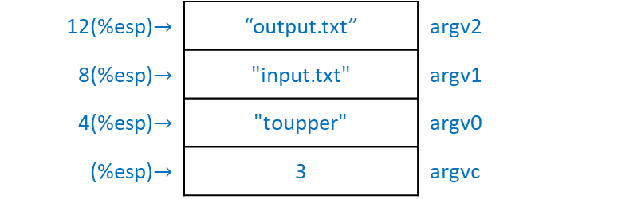
ToUpper Constants: start of program
  .section .bss
  .equ BUFFER_SIZE, 500 # buffer size = 500 bytes
  .lcomm BUFFER_DATA, BUFFER_SIZE # actual buffer
  .section .text
  # stack positions: where in the stack to find each piece of data
  .equ ST_SIZE_RESERVE, 8 # buffer size
  .equ ST_FD_IN, -4 # input file descriptor
  .equ ST_FD_OUT, -8 # output file descriptor
  .equ ST_ARGC, 0 # number of arguments
  .equ ST_ARGV_0, 4 # name of program
  .equ ST_ARGV_1, 8 # input file name
  .equ ST_ARGV_2, 12 # output file name
  .globl _start
_start:
  ### INITIALIZE PROGRAM ###
  movl %esp, %ebp # save stack pointer
  subl $ST_SIZE_RESERVE, %esp # allocate space on stack
  # for file descriptors
12(%esp)$→$ | “output.txt” | argv2
8(%esp)$→$ | "input.txt" | argv1
4(%esp)$→$ | "toupper" | argv0
(%esp)$→$ | 3 | argvc
argv array

Slide 28
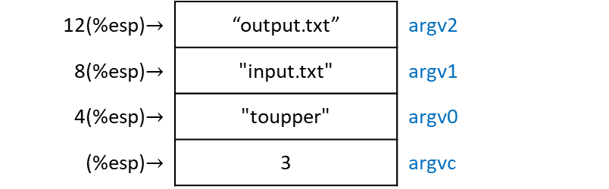
ToUpper Constants: start of program
  .section .bss
  .equ BUFFER_SIZE, 500 # buffer size = 500 bytes
  .lcomm BUFFER_DATA, BUFFER_SIZE # actual buffer
  .section .text
  # stack positions: where in the stack to find each piece of data
  .equ ST_SIZE_RESERVE, 8 # buffer size
  .equ ST_FD_IN, -4 # input file descriptor
  .equ ST_FD_OUT, -8 # output file descriptor
  .equ ST_ARGC, 0 # number of arguments
  .equ ST_ARGV_0, 4 # name of program
  .equ ST_ARGV_1, 8 # input file name
  .equ ST_ARGV_2, 12 # output file name
  .globl _start
_start:
  ### INITIALIZE PROGRAM ###
  movl %esp, %ebp # save stack pointer
  subl $ST_SIZE_RESERVE, %esp # allocate space on stack
  # for file descriptors
argvc
./toupper input.txt output.txt
argv0 arvg1 argv2
12(%esp)$→$ | “output.txt” | argv2
8(%esp)$→$ | "input.txt" | argv1
4(%esp)$→$ | "toupper" | argv0
(%esp)$→$ | 3 | argvc
argv array

Slide 29
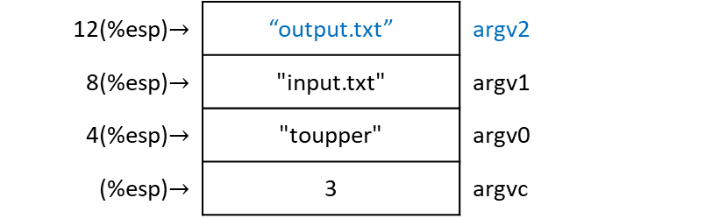
ToUpper Constants: start of program
  .section .bss
  .equ BUFFER_SIZE, 500 # buffer size = 500 bytes
  .lcomm BUFFER_DATA, BUFFER_SIZE # actual buffer
  .section .text
  # stack positions: where in the stack to find each piece of data
  .equ ST_SIZE_RESERVE, 8 # buffer size
  .equ ST_FD_IN, -4 # input file descriptor
  .equ ST_FD_OUT, -8 # output file descriptor
  .equ ST_ARGC, 0 # number of arguments
  .equ ST_ARGV_0, 4 # name of program
  .equ ST_ARGV_1, 8 # input file name
  .equ ST_ARGV_2, 12 # output file name
  .globl _start
_start:
  ### INITIALIZE PROGRAM ###
  movl %esp, %ebp # save stack pointer
  subl $ST_SIZE_RESERVE, %esp # allocate space on stack
  # for file descriptors
argvc
./toupper input.txt output.txt
argv0 arvg1 argv2
12(%esp)$→$ | “output.txt” | argv2
8(%esp)$→$ | "input.txt" | argv1
4(%esp)$→$ | "toupper" | argv0
(%esp)$→$ | 3 | argvc
argv array

Slide 30
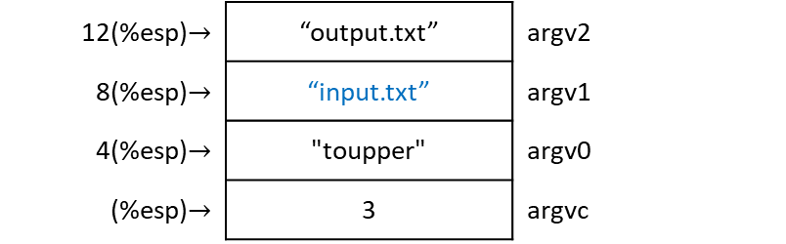
ToUpper Constants: start of program
  .section .bss
  .equ BUFFER_SIZE, 500 # buffer size = 500 bytes
  .lcomm BUFFER_DATA, BUFFER_SIZE # actual buffer
  .section .text
  # stack positions: where in the stack to find each piece of data
  .equ ST_SIZE_RESERVE, 8 # buffer size
  .equ ST_FD_IN, -4 # input file descriptor
  .equ ST_FD_OUT, -8 # output file descriptor
  .equ ST_ARGC, 0 # number of arguments
  .equ ST_ARGV_0, 4 # name of program
  .equ ST_ARGV_1, 8 # input file name
  .equ ST_ARGV_2, 12 # output file name
  .globl _start
_start:
  ### INITIALIZE PROGRAM ###
  movl %esp, %ebp # save stack pointer
  subl $ST_SIZE_RESERVE, %esp # allocate space on stack
  # for file descriptors
argvc
./toupper input.txt output.txt
argv0 arvg1 argv2
12(%esp)$→$ | “output.txt” | argv2
8(%esp)$→$ | “input.txt” | argv1
4(%esp)$→$ | "toupper" | argv0
(%esp)$→$ | 3 | argvc
argv array

Slide 31
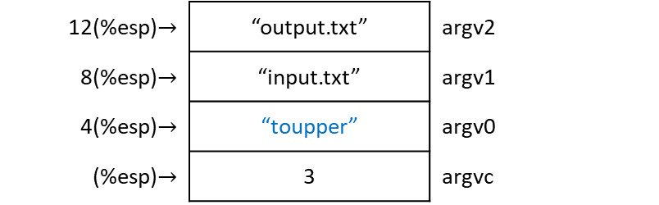
ToUpper Constants: start of program
  .section .bss
  .equ BUFFER_SIZE, 500 # buffer size = 500 bytes
  .lcomm BUFFER_DATA, BUFFER_SIZE # actual buffer
  .section .text
  # stack positions: where in the stack to find each piece of data
  .equ ST_SIZE_RESERVE, 8 # buffer size
  .equ ST_FD_IN, -4 # input file descriptor
  .equ ST_FD_OUT, -8 # output file descriptor
  .equ ST_ARGC, 0 # number of arguments
  .equ ST_ARGV_0, 4 # name of program
  .equ ST_ARGV_1, 8 # input file name
  .equ ST_ARGV_2, 12 # output file name
  .globl _start
_start:
  ### INITIALIZE PROGRAM ###
  movl %esp, %ebp # save stack pointer
  subl $ST_SIZE_RESERVE, %esp # allocate space on stack
  # for file descriptors
argvc
./toupper input.txt output.txt
argv0 arvg1 argv2
12(%esp)$→$ | “output.txt” | argv2
8(%esp)$→$ | “input.txt” | argv1
4(%esp)$→$ | “toupper” | argv0
(%esp)$→$ | 3 | argvc
argv array

Slide 32
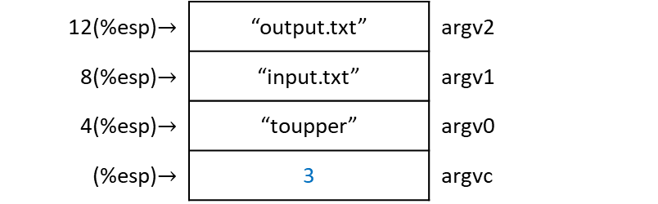
ToUpper Constants: start of program
  .section .bss
  .equ BUFFER_SIZE, 500 # buffer size = 500 bytes
  .lcomm BUFFER_DATA, BUFFER_SIZE # actual buffer
  .section .text
  # stack positions: where in the stack to find each piece of data
  .equ ST_SIZE_RESERVE, 8 # buffer size
  .equ ST_FD_IN, -4 # input file descriptor
  .equ ST_FD_OUT, -8 # output file descriptor
  .equ ST_ARGC, 0 # number of arguments
  .equ ST_ARGV_0, 4 # name of program
  .equ ST_ARGV_1, 8 # input file name
  .equ ST_ARGV_2, 12 # output file name
  .globl _start
_start:
  ### INITIALIZE PROGRAM ###
  movl %esp, %ebp # save stack pointer
  subl $ST_SIZE_RESERVE, %esp # allocate space on stack
  # for file descriptors
argvc
./toupper input.txt output.txt
argv0 arvg1 argv2
12(%esp)$→$ | “output.txt” | argv2
8(%esp)$→$ | “input.txt” | argv1
4(%esp)$→$ | “toupper” | argv0
(%esp)$→$ | 3 | argvc
argv array

Slide 33
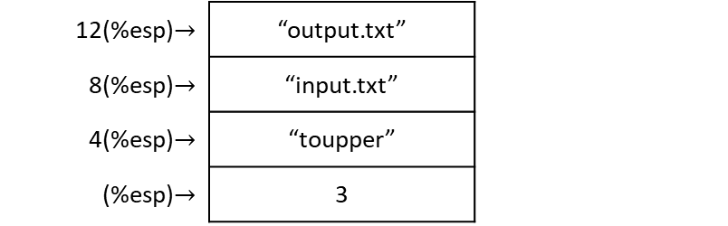
ToUpper Constants: start of program
  .section .bss
  .equ BUFFER_SIZE, 500 # buffer size = 500 bytes
  .lcomm BUFFER_DATA, BUFFER_SIZE # actual buffer
  .section .text
  # stack positions: where in the stack to find each piece of data
  .equ ST_SIZE_RESERVE, 8 # buffer size
  .equ ST_FD_IN, -4 # input file descriptor
  .equ ST_FD_OUT, -8 # output file descriptor
  .equ ST_ARGC, 0 # number of arguments
  .equ ST_ARGV_0, 4 # name of program
  .equ ST_ARGV_1, 8 # input file name
  .equ ST_ARGV_2, 12 # output file name
  .globl _start
_start:
  ### INITIALIZE PROGRAM ###
  movl %esp, %ebp # save stack pointer
  subl $ST_SIZE_RESERVE, %esp # allocate space on stack
  # for file descriptors
12(%esp)$→$ | “output.txt”
8(%esp)$→$ | “input.txt”
4(%esp)$→$ | “toupper”
(%esp)$→$ | 3

Slide 34
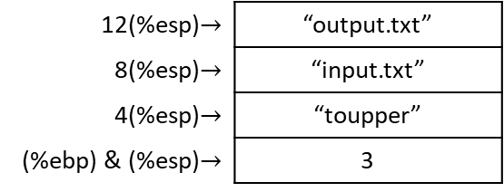
ToUpper Save stack pointer
  .section .bss
  .equ BUFFER_SIZE, 500 # buffer size = 500 bytes
  .lcomm BUFFER_DATA, BUFFER_SIZE # actual buffer
  .section .text
  # stack positions: where in the stack to find each piece of data
  .equ ST_SIZE_RESERVE, 8 # buffer size
  .equ ST_FD_IN, -4 # input file descriptor
  .equ ST_FD_OUT, -8 # output file descriptor
  .equ ST_ARGC, 0 # number of arguments
  .equ ST_ARGV_0, 4 # name of program
  .equ ST_ARGV_1, 8 # input file name
  .equ ST_ARGV_2, 12 # output file name
  .globl _start
_start:
  ### INITIALIZE PROGRAM ###
  movl %esp, %ebp # save stack pointer
  subl $ST_SIZE_RESERVE, %esp # allocate space on stack
  # for file descriptors
12(%esp)$→$ | “output.txt”
8(%esp)$→$ | “input.txt”
4(%esp)$→$ | “toupper”
(%ebp) & (%esp)$→$ | 3

Slide 35
ToUpper Save stack pointer
  .section .bss
  .equ BUFFER_SIZE, 500 # buffer size = 500 bytes
  .lcomm BUFFER_DATA, BUFFER_SIZE # actual buffer
  .section .text
  # stack positions: where in the stack to find each piece of data
  .equ ST_SIZE_RESERVE, 8 # buffer size
  .equ ST_FD_IN, -4 # input file descriptor
  .equ ST_FD_OUT, -8 # output file descriptor
  .equ ST_ARGC, 0 # number of arguments
  .equ ST_ARGV_0, 4 # name of program
  .equ ST_ARGV_1, 8 # input file name
  .equ ST_ARGV_2, 12 # output file name
  .globl _start
_start:
  ### INITIALIZE PROGRAM ###
  movl %esp, %ebp # save stack pointer
  subl $ST_SIZE_RESERVE, %esp # allocate space on stack
  # for file descriptors
12(%esp)$→$ | “output.txt”
8(%esp)$→$ | “input.txt”
4(%esp)$→$ | “toupper”
(%ebp) & (%esp)$→$ | 3

Slide 36
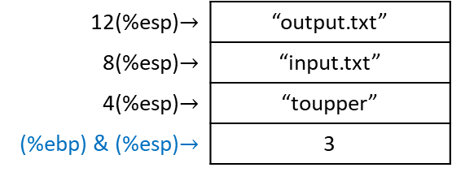
ToUpper Save stack pointer
  .section .bss
  .equ BUFFER_SIZE, 500 # buffer size = 500 bytes
  .lcomm BUFFER_DATA, BUFFER_SIZE # actual buffer
  .section .text
  # stack positions: where in the stack to find each piece of data
  .equ ST_SIZE_RESERVE, 8 # buffer size
  .equ ST_FD_IN, -4 # input file descriptor
  .equ ST_FD_OUT, -8 # output file descriptor
  .equ ST_ARGC, 0 # number of arguments
  .equ ST_ARGV_0, 4 # name of program
  .equ ST_ARGV_1, 8 # input file name
  .equ ST_ARGV_2, 12 # output file name
  .globl _start
_start:
  ### INITIALIZE PROGRAM ###
  movl %esp, %ebp # save stack pointer
  subl $ST_SIZE_RESERVE, %esp # allocate space on stack
  # for file descriptors
12(%esp)$→$ | “output.txt”
8(%esp)$→$ | “input.txt”
4(%esp)$→$ | “toupper”
(%ebp) & (%esp)$→$ | 3

Slide 37
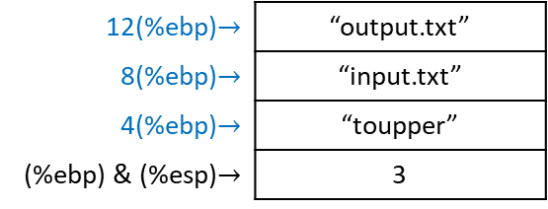
ToUpper Refer to %ebp
  .section .bss
  .equ BUFFER_SIZE, 500 # buffer size = 500 bytes
  .lcomm BUFFER_DATA, BUFFER_SIZE # actual buffer
  .section .text
  # stack positions: where in the stack to find each piece of data
  .equ ST_SIZE_RESERVE, 8 # buffer size
  .equ ST_FD_IN, -4 # input file descriptor
  .equ ST_FD_OUT, -8 # output file descriptor
  .equ ST_ARGC, 0 # number of arguments
  .equ ST_ARGV_0, 4 # name of program
  .equ ST_ARGV_1, 8 # input file name
  .equ ST_ARGV_2, 12 # output file name
  .globl _start
_start:
  ### INITIALIZE PROGRAM ###
  movl %esp, %ebp # save stack pointer
  subl $ST_SIZE_RESERVE, %esp # allocate space on stack
  # for file descriptors
12(%ebp)$→$ | “output.txt”
8(%ebp)$→$ | “input.txt”
4(%ebp)$→$ | “toupper”
(%ebp) & (%esp)$→$ | 3

Slide 38
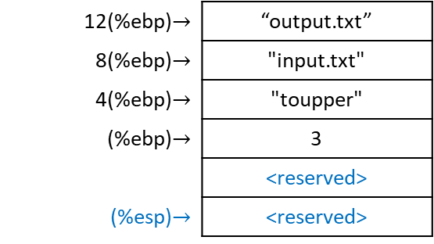
ToUpper Allocate for file descriptors
  .section .bss
  .equ BUFFER_SIZE, 500 # buffer size = 500 bytes
  .lcomm BUFFER_DATA, BUFFER_SIZE # actual buffer
  .section .text
  # stack positions: where in the stack to find each piece of data
  .equ ST_SIZE_RESERVE, 8 # buffer size
  .equ ST_FD_IN, -4 # input file descriptor
  .equ ST_FD_OUT, -8 # output file descriptor
  .equ ST_ARGC, 0 # number of arguments
  .equ ST_ARGV_0, 4 # name of program
  .equ ST_ARGV_1, 8 # input file name
  .equ ST_ARGV_2, 12 # output file name
  .globl _start
_start:
  ### INITIALIZE PROGRAM ###
  movl %esp, %ebp # save stack pointer
  subl $ST_SIZE_RESERVE, %esp # allocate space on stack
  # for file descriptors
12(%ebp)$→$ | “output.txt”
8(%ebp)$→$ | "input.txt"
4(%ebp)$→$ | "toupper"
(%ebp)$→$ | 3
 | <reserved>
(%esp)$→$ | <reserved>
%esp = %esp - ST_SIZE_RESERVE = %esp - 8

Slide 39
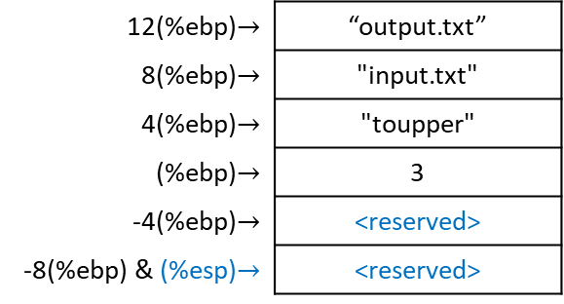
ToUpper Allocate for file descriptors
  .section .bss
  .equ BUFFER_SIZE, 500 # buffer size = 500 bytes
  .lcomm BUFFER_DATA, BUFFER_SIZE # actual buffer
  .section .text
  # stack positions: where in the stack to find each piece of data
  .equ ST_SIZE_RESERVE, 8 # buffer size
  .equ ST_FD_IN, -4 # input file descriptor
  .equ ST_FD_OUT, -8 # output file descriptor
  .equ ST_ARGC, 0 # number of arguments
  .equ ST_ARGV_0, 4 # name of program
  .equ ST_ARGV_1, 8 # input file name
  .equ ST_ARGV_2, 12 # output file name
  .globl _start
_start:
  ### INITIALIZE PROGRAM ###
  movl %esp, %ebp # save stack pointer
  subl $ST_SIZE_RESERVE, %esp # allocate space on stack
  # for file descriptors
12(%ebp)$→$ | “output.txt”
8(%ebp)$→$ | "input.txt"
4(%ebp)$→$ | "toupper"
(%ebp)$→$ | 3
-4(%ebp)$→$ | <reserved>
-8(%ebp) & (%esp)$→$ | <reserved>
%esp = %esp - ST_SIZE_RESERVE = %esp - 8

Slide 40
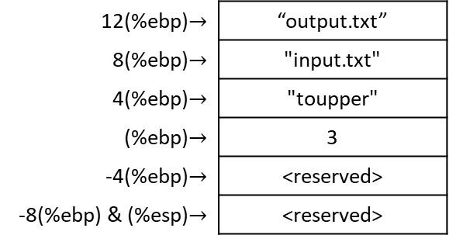
ToUpper Open input file
open_files:
open_fd_in:
  ### OPEN INPUT FILE ###
  movl $SYS_OPEN, %eax # open input file (syscall 5)
  movl ST_ARGV_1(%ebp), %ebx # input filename from command line
  # into %ebx (%ebx now contains
  # pointer in the stack to
  # null-terminated string)
  movl $O_RDONLY, %ecx # read-only flag
  movl $0666, %edx # permissions when creating file
  # (this doesn’t really matter
  # for reading)
  int $LINUX_SYSCALL # execute system call
  # Linux returns file descriptor in %eax
store_fd_in:
  movl %eax, ST_FD_IN(%ebp) # transfer file descriptor from %eax
  # to its appropriate place in the stack
12(%ebp)$→$ | “output.txt”
8(%ebp)$→$ | "input.txt"
4(%ebp)$→$ | "toupper"
(%ebp)$→$ | 3
-4(%ebp)$→$ | <reserved>
-8(%ebp) & (%esp)$→$ | <reserved>
.equ SYS_OPEN, 5
EAX = 5

Slide 41
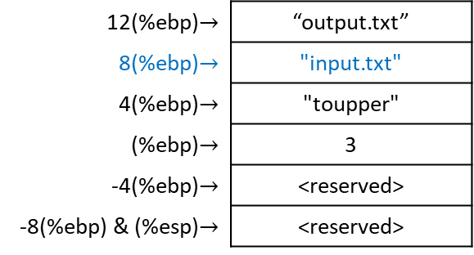
ToUpper Open input file
open_files:
open_fd_in:
  ### OPEN INPUT FILE ###
  movl $SYS_OPEN, %eax # open input file (syscall 5)
  movl ST_ARGV_1(%ebp), %ebx # input filename from command line
  # into %ebx (%ebx now contains
  # pointer in the stack to
  # null-terminated string)
  movl $O_RDONLY, %ecx # read-only flag
  movl $0666, %edx # permissions when creating file
  # (this doesn’t really matter
  # for reading)
  int $LINUX_SYSCALL # execute system call
  # Linux returns file descriptor in %eax
store_fd_in:
  movl %eax, ST_FD_IN(%ebp) # transfer file descriptor from %eax
  # to its appropriate place in the stack
12(%ebp)$→$ | “output.txt”
8(%ebp)$→$ | "input.txt"
4(%ebp)$→$ | "toupper"
(%ebp)$→$ | 3
-4(%ebp)$→$ | <reserved>
-8(%ebp) & (%esp)$→$ | <reserved>
.equ ST_ARGV_1, 8
EAX = 5
EBX = "input.txt"

Slide 42
ToUpper Open input file
open_files:
open_fd_in:
  ### OPEN INPUT FILE ###
  movl $SYS_OPEN, %eax # open input file (syscall 5)
  movl ST_ARGV_1(%ebp), %ebx # input filename from command line
  # into %ebx (%ebx now contains
  # pointer in the stack to
  # null-terminated string)
  movl $O_RDONLY, %ecx # read-only flag
  movl $0666, %edx # permissions when creating file
  # (this doesn’t really matter
  # for reading)
  int $LINUX_SYSCALL # execute system call
  # Linux returns file descriptor in %eax
store_fd_in:
  movl %eax, ST_FD_IN(%ebp) # transfer file descriptor from %eax
  # to its appropriate place in the stack
12(%ebp)$→$ | “output.txt”
8(%ebp)$→$ | "input.txt"
4(%ebp)$→$ | "toupper"
(%ebp)$→$ | 3
-4(%ebp)$→$ | <reserved>
-8(%ebp) & (%esp)$→$ | <reserved>
.equ O_RDONLY, 0
EAX = 5
EBX = "input.txt"
ECX = 0

Slide 43
ToUpper Open input file
open_files:
open_fd_in:
  ### OPEN INPUT FILE ###
  movl $SYS_OPEN, %eax # open input file (syscall 5)
  movl ST_ARGV_1(%ebp), %ebx # input filename from command line
  # into %ebx (%ebx now contains
  # pointer in the stack to
  # null-terminated string)
  movl $O_RDONLY, %ecx # read-only flag
  movl $0666, %edx # permissions when creating file
  # (this doesn’t really matter
  # for reading)
  int $LINUX_SYSCALL # execute system call
  # Linux returns file descriptor in %eax
store_fd_in:
  movl %eax, ST_FD_IN(%ebp) # transfer file descriptor from %eax
  # to its appropriate place in the stack
12(%ebp)$→$ | “output.txt”
8(%ebp)$→$ | "input.txt"
4(%ebp)$→$ | "toupper"
(%ebp)$→$ | 3
-4(%ebp)$→$ | <reserved>
-8(%ebp) & (%esp)$→$ | <reserved>
EAX = 5
EBX = "input.txt"
ECX = 0
EDX = 0666

Slide 44
ToUpper Open input file
open_files:
open_fd_in:
  ### OPEN INPUT FILE ###
  movl $SYS_OPEN, %eax # open input file (syscall 5)
  movl ST_ARGV_1(%ebp), %ebx # input filename from command line
  # into %ebx (%ebx now contains
  # pointer in the stack to
  # null-terminated string)
  movl $O_RDONLY, %ecx # read-only flag
  movl $0666, %edx # permissions when creating file
  # (this doesn’t really matter
  # for reading)
  int $LINUX_SYSCALL # execute system call
  # Linux returns file descriptor in %eax
store_fd_in:
  movl %eax, ST_FD_IN(%ebp) # transfer file descriptor from %eax
  # to its appropriate place in the stack
12(%ebp)$→$ | “output.txt”
8(%ebp)$→$ | "input.txt"
4(%ebp)$→$ | "toupper"
(%ebp)$→$ | 3
-4(%ebp)$→$ | <reserved>
-8(%ebp) & (%esp)$→$ | <reserved>
.equ LINUX_SYSCALL, 0x80
EAX = input file descriptor
EBX = "input.txt"
ECX = 0
EDX = 0666

Slide 45
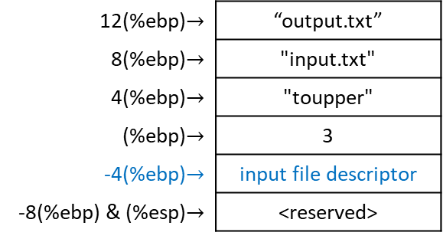
ToUpper Open input file
open_files:
open_fd_in:
  ### OPEN INPUT FILE ###
  movl $SYS_OPEN, %eax # open input file (syscall 5)
  movl ST_ARGV_1(%ebp), %ebx # input filename from command line
  # into %ebx (%ebx now contains
  # pointer in the stack to
  # null-terminated string)
  movl $O_RDONLY, %ecx # read-only flag
  movl $0666, %edx # permissions when creating file
  # (this doesn’t really matter
  # for reading)
  int $LINUX_SYSCALL # execute system call
  # Linux returns file descriptor in %eax
store_fd_in:
  movl %eax, ST_FD_IN(%ebp) # transfer file descriptor from %eax
  # to its appropriate place in the stack
12(%ebp)$→$ | “output.txt”
8(%ebp)$→$ | "input.txt"
4(%ebp)$→$ | "toupper"
(%ebp)$→$ | 3
-4(%ebp)$→$ | input file descriptor
-8(%ebp) & (%esp)$→$ | <reserved>
.equ ST_FD_IN, -4
EAX = input file descriptor
EBX = "input.txt"
ECX = 0
EDX = 0666

Slide 46
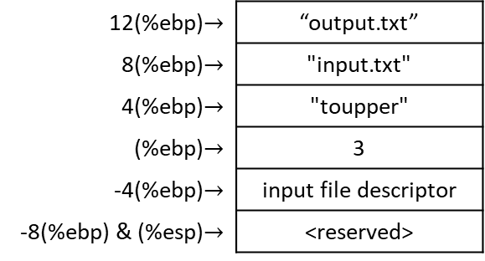
ToUpper Open input file
open_files:
open_fd_in:
  ### OPEN INPUT FILE ###
  movl $SYS_OPEN, %eax # open input file (syscall 5)
  movl ST_ARGV_1(%ebp), %ebx # input filename from command line
  # into %ebx (%ebx now contains
  # pointer in the stack to
  # null-terminated string)
  movl $O_RDONLY, %ecx # read-only flag
  movl $0666, %edx # permissions when creating file
  # (this doesn’t really matter
  # for reading)
  int $LINUX_SYSCALL # execute system call
  # Linux returns file descriptor in %eax
store_fd_in:
  movl %eax, ST_FD_IN(%ebp) # transfer file descriptor from %eax
  # to its appropriate place in the stack
12(%ebp)$→$ | “output.txt”
8(%ebp)$→$ | "input.txt"
4(%ebp)$→$ | "toupper"
(%ebp)$→$ | 3
-4(%ebp)$→$ | input file descriptor
-8(%ebp) & (%esp)$→$ | <reserved>
EAX = input file descriptor
EBX = "input.txt"
ECX = 0
EDX = 0666
Normally, we check system call for success/failure. If failure, error code (negative) held in %eax instead of return value.

Slide 47
ToUpper Open output file
open_fd_out:
  ### OPEN OUTPUT FILE ###
  movl $SYS_OPEN, %eax # open output file (syscall 5)
  movl ST_ARGV_2(%ebp), %ebx # output filename from command line
  # into %ebx (%ebx now contains
  # pointer in the stack to
  # null-terminated string)
  movl $O_CREAT_WRONLY_TRUNC, %ecx # write-only flag
  movl $0666, %edx # permissions when creating file:
  # write-only, create-if-doesn’t-exist,
  # truncate-if-doesn’t-exist
  int $LINUX_SYSCALL # execute system call
  # Linux returns file descriptor in %eax
store_fd_out:
  movl %eax, ST_FD_OUT(%ebp) # transfer file descriptor from %eax
  # to its appropriate place in the stack
12(%ebp)$→$ | “output.txt”
8(%ebp)$→$ | "input.txt"
4(%ebp)$→$ | "toupper"
(%ebp)$→$ | 3
-4(%ebp)$→$ | input file descriptor
-8(%ebp) & (%esp)$→$ | <reserved>
.equ SYS_OPEN, 5
EAX = 5
EBX = "input.txt"
ECX = 0
EDX = 0666

Slide 48
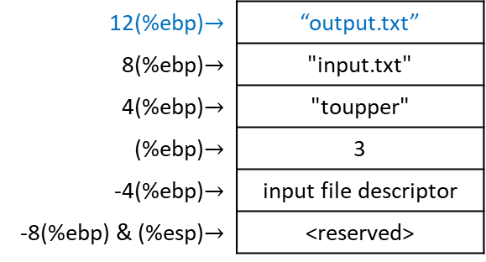
ToUpper Open output file
open_fd_out:
  ### OPEN OUTPUT FILE ###
  movl $SYS_OPEN, %eax # open output file (syscall 5)
  movl ST_ARGV_2(%ebp), %ebx # output filename from command line
  # into %ebx (%ebx now contains
  # pointer in the stack to
  # null-terminated string)
  movl $O_CREAT_WRONLY_TRUNC, %ecx # write-only flag
  movl $0666, %edx # permissions when creating file:
  # write-only, create-if-doesn’t-exist,
  # truncate-if-doesn’t-exist
  int $LINUX_SYSCALL # execute system call
  # Linux returns file descriptor in %eax
store_fd_out:
  movl %eax, ST_FD_OUT(%ebp) # transfer file descriptor from %eax
  # to its appropriate place in the stack
12(%ebp)$→$ | “output.txt”
8(%ebp)$→$ | "input.txt"
4(%ebp)$→$ | "toupper"
(%ebp)$→$ | 3
-4(%ebp)$→$ | input file descriptor
-8(%ebp) & (%esp)$→$ | <reserved>
.equ ST_ARGV_2, 12
EAX = 5
EBX = “output.txt”
ECX = 0
EDX = 0666

Slide 49
ToUpper Open output file
open_fd_out:
  ### OPEN OUTPUT FILE ###
  movl $SYS_OPEN, %eax # open output file (syscall 5)
  movl ST_ARGV_2(%ebp), %ebx # output filename from command line
  # into %ebx (%ebx now contains
  # pointer in the stack to
  # null-terminated string)
  movl $O_CREAT_WRONLY_TRUNC, %ecx # write-only flag
  movl $0666, %edx # permissions when creating file:
  # write-only, create-if-doesn’t-exist,
  # truncate-if-doesn’t-exist
  int $LINUX_SYSCALL # execute system call
  # Linux returns file descriptor in %eax
store_fd_out:
  movl %eax, ST_FD_OUT(%ebp) # transfer file descriptor from %eax
  # to its appropriate place in the stack
12(%ebp)$→$ | “output.txt”
8(%ebp)$→$ | "input.txt"
4(%ebp)$→$ | "toupper"
(%ebp)$→$ | 3
-4(%ebp)$→$ | input file descriptor
-8(%ebp) & (%esp)$→$ | <reserved>
.equ O_CREAT_WRONLY_TRUNC, 03101
EAX = 5
EBX = “output.txt”
ECX = 03101
EDX = 0666

Slide 50
ToUpper Open output file
open_fd_out:
  ### OPEN OUTPUT FILE ###
  movl $SYS_OPEN, %eax # open output file (syscall 5)
  movl ST_ARGV_2(%ebp), %ebx # output filename from command line
  # into %ebx (%ebx now contains
  # pointer in the stack to
  # null-terminated string)
  movl $O_CREAT_WRONLY_TRUNC, %ecx # write-only flag
  movl $0666, %edx # permissions when creating file:
  # write-only, create-if-doesn’t-exist,
  # truncate-if-doesn’t-exist
  int $LINUX_SYSCALL # execute system call
  # Linux returns file descriptor in %eax
store_fd_out:
  movl %eax, ST_FD_OUT(%ebp) # transfer file descriptor from %eax
  # to its appropriate place in the stack
12(%ebp)$→$ | “output.txt”
8(%ebp)$→$ | "input.txt"
4(%ebp)$→$ | "toupper"
(%ebp)$→$ | 3
-4(%ebp)$→$ | input file descriptor
-8(%ebp) & (%esp)$→$ | <reserved>
EAX = 5
EBX = “output.txt”
ECX = 03101
EDX = 0666

Slide 51
ToUpper Open output file
open_fd_out:
  ### OPEN OUTPUT FILE ###
  movl $SYS_OPEN, %eax # open output file (syscall 5)
  movl ST_ARGV_2(%ebp), %ebx # output filename from command line
  # into %ebx (%ebx now contains
  # pointer in the stack to
  # null-terminated string)
  movl $O_CREAT_WRONLY_TRUNC, %ecx # write-only flag
  movl $0666, %edx # permissions when creating file:
  # write-only, create-if-doesn’t-exist,
  # truncate-if-doesn’t-exist
  int $LINUX_SYSCALL # execute system call
  # Linux returns file descriptor in %eax
store_fd_out:
  movl %eax, ST_FD_OUT(%ebp) # transfer file descriptor from %eax
  # to its appropriate place in the stack
12(%ebp)$→$ | “output.txt”
8(%ebp)$→$ | "input.txt"
4(%ebp)$→$ | "toupper"
(%ebp)$→$ | 3
-4(%ebp)$→$ | input file descriptor
-8(%ebp) & (%esp)$→$ | <reserved>
.equ LINUX_SYSCALL, 0x80
EAX = output file descriptor
EBX = “output.txt”
ECX = 03101
EDX = 0666

Slide 52
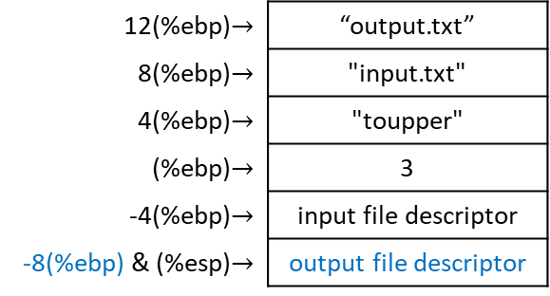
ToUpper Open output file
open_fd_out:
  ### OPEN OUTPUT FILE ###
  movl $SYS_OPEN, %eax # open output file (syscall 5)
  movl ST_ARGV_2(%ebp), %ebx # output filename from command line
  # into %ebx (%ebx now contains
  # pointer in the stack to
  # null-terminated string)
  movl $O_CREAT_WRONLY_TRUNC, %ecx # write-only flag
  movl $0666, %edx # permissions when creating file:
  # write-only, create-if-doesn’t-exist,
  # truncate-if-doesn’t-exist
  int $LINUX_SYSCALL # execute system call
  # Linux returns file descriptor in %eax
store_fd_out:
  movl %eax, ST_FD_OUT(%ebp) # transfer file descriptor from %eax
  # to its appropriate place in the stack
12(%ebp)$→$ | “output.txt”
8(%ebp)$→$ | "input.txt"
4(%ebp)$→$ | "toupper"
(%ebp)$→$ | 3
-4(%ebp)$→$ | input file descriptor
-8(%ebp) & (%esp)$→$ | output file descriptor
.equ ST_FD_OUT, -8
EAX = output file descriptor
EBX = “output.txt”
ECX = 03101
EDX = 0666

Slide 53
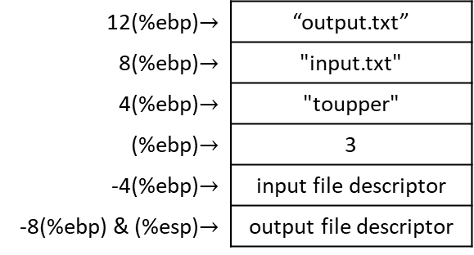
ToUpper main loop = read_loop_begin + continue_read_loop + end_loop
  ### BEGIN MAIN LOOP ###
read_loop_begin:
  ### READ IN A BLOCK FROM THE INPUT FILE ###
  movl $SYS_READ, %eax # read input file (syscall 3)
  movl ST_FD_IN(%ebp), %ebx # get input file descriptor
  movl $BUFFER_DATA, %ecx # location to read from
  movl $BUFFER_SIZE, %edx # size of buffer
  int $LINUX_SYSCALL # size of buffer read is
  # returned in %eax, returns
  # number of bytes actually read
  # or end-of-file (the number 0)
  ### EXIT IF WE’VE REACHED THE END ###
  cmpl $END_OF_FILE, %eax # check %eax for end-of-file marker
  jle end_loop # if found, or on error, go to the end
12(%ebp)$→$ | “output.txt”
8(%ebp)$→$ | "input.txt"
4(%ebp)$→$ | "toupper"
(%ebp)$→$ | 3
-4(%ebp)$→$ | input file descriptor
-8(%ebp) & (%esp)$→$ | output file descriptor
EAX = output file descriptor
EBX = “output.txt”
ECX = 03101
EDX = 0666

Slide 54
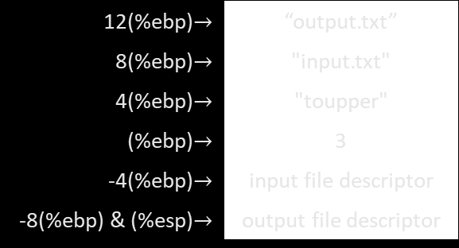
ToUpper main loop = read_loop_begin + continue_read_loop + end_loop
  ### BEGIN MAIN LOOP ###
read_loop_begin:
  ### READ IN A BLOCK FROM THE INPUT FILE ###
  movl $SYS_READ, %eax # read input file (syscall 3)
  movl ST_FD_IN(%ebp), %ebx # get input file descriptor
  movl $BUFFER_DATA, %ecx # location to read from
  movl $BUFFER_SIZE, %edx # size of buffer
  int $LINUX_SYSCALL # size of buffer read is
  # returned in %eax, returns
  # number of bytes actually read
  # or end-of-file (the number 0)
  ### EXIT IF WE’VE REACHED THE END ###
  cmpl $END_OF_FILE, %eax # check %eax for end-of-file marker
  jle end_loop # if found, or on error, go to the end
12(%ebp)$→$ | “output.txt”
8(%ebp)$→$ | "input.txt"
4(%ebp)$→$ | "toupper"
(%ebp)$→$ | 3
-4(%ebp)$→$ | input file descriptor
-8(%ebp) & (%esp)$→$ | output file descriptor
read/write loop:
read fixed-sized chunk from input file,
convert it,
write back to output file (in this case fixed-sized chunks don’t really matter)
EAX = output file descriptor
EBX = “output.txt”
ECX = 03101
EDX = 0666

Slide 55
ToUpper main loop = read_loop_begin + continue_read_loop + end_loop
  ### BEGIN MAIN LOOP ###
read_loop_begin:
  ### READ IN A BLOCK FROM THE INPUT FILE ###
  movl $SYS_READ, %eax # read input file (syscall 3)
  movl ST_FD_IN(%ebp), %ebx # get input file descriptor
  movl $BUFFER_DATA, %ecx # location to read from
  movl $BUFFER_SIZE, %edx # size of buffer
  int $LINUX_SYSCALL # size of buffer read is
  # returned in %eax, returns
  # number of bytes actually read
  # or end-of-file (the number 0)
  ### EXIT IF WE’VE REACHED THE END ###
  cmpl $END_OF_FILE, %eax # check %eax for end-of-file marker
  jle end_loop # if found, or on error, go to the end
12(%ebp)$→$ | “output.txt”
8(%ebp)$→$ | "input.txt"
4(%ebp)$→$ | "toupper"
(%ebp)$→$ | 3
-4(%ebp)$→$ | input file descriptor
-8(%ebp) & (%esp)$→$ | output file descriptor
read/write loop:
read fixed-sized chunk from input file,
convert it,
write back to output file (in this case fixed-sized chunks don’t really matter)
EAX = output file descriptor
EBX = “output.txt”
ECX = 03101
EDX = 0666

Slide 56
ToUpper main loop = read_loop_begin + continue_read_loop + end_loop
  ### BEGIN MAIN LOOP ###
read_loop_begin:
  ### READ IN A BLOCK FROM THE INPUT FILE ###
  movl $SYS_READ, %eax # read input file (syscall 3)
  movl ST_FD_IN(%ebp), %ebx # get input file descriptor
  movl $BUFFER_DATA, %ecx # location to read from
  movl $BUFFER_SIZE, %edx # size of buffer
  int $LINUX_SYSCALL # size of buffer read is
  # returned in %eax, returns
  # number of bytes actually read
  # or end-of-file (the number 0)
  ### EXIT IF WE’VE REACHED THE END ###
  cmpl $END_OF_FILE, %eax # check %eax for end-of-file marker
  jle end_loop # if found, or on error, go to the end
12(%ebp)$→$ | “output.txt”
8(%ebp)$→$ | "input.txt"
4(%ebp)$→$ | "toupper"
(%ebp)$→$ | 3
-4(%ebp)$→$ | input file descriptor
-8(%ebp) & (%esp)$→$ | output file descriptor
read/write loop:
read fixed-sized chunk from input file,
convert it,
write back to output file (in this case fixed-sized chunks don’t really matter)
EAX = output file descriptor
EBX = “output.txt”
ECX = 03101
EDX = 0666

Slide 57
ToUpper main loop = read_loop_begin + continue_read_loop + end_loop
  ### BEGIN MAIN LOOP ###
read_loop_begin:
  ### READ IN A BLOCK FROM THE INPUT FILE ###
  movl $SYS_READ, %eax # read input file (syscall 3)
  movl ST_FD_IN(%ebp), %ebx # get input file descriptor
  movl $BUFFER_DATA, %ecx # location to read from
  movl $BUFFER_SIZE, %edx # size of buffer
  int $LINUX_SYSCALL # size of buffer read is
  # returned in %eax, returns
  # number of bytes actually read
  # or end-of-file (the number 0)
  ### EXIT IF WE’VE REACHED THE END ###
  cmpl $END_OF_FILE, %eax # check %eax for end-of-file marker
  jle end_loop # if found, or on error, go to the end
12(%ebp)$→$ | “output.txt”
8(%ebp)$→$ | "input.txt"
4(%ebp)$→$ | "toupper"
(%ebp)$→$ | 3
-4(%ebp)$→$ | input file descriptor
-8(%ebp) & (%esp)$→$ | output file descriptor
.equ SYS_READ, 3
.equ SYS_READ, 3
EAX = 3
EBX = “output.txt”
ECX = 03101
EDX = 0666

Slide 58
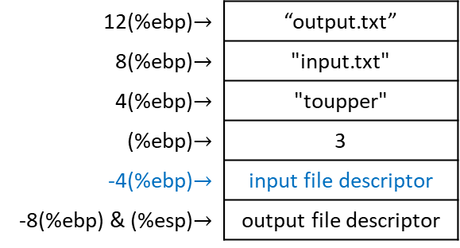
ToUpper main loop = read_loop_begin + continue_read_loop + end_loop
  ### BEGIN MAIN LOOP ###
read_loop_begin:
  ### READ IN A BLOCK FROM THE INPUT FILE ###
  movl $SYS_READ, %eax # read input file (syscall 3)
  movl ST_FD_IN(%ebp), %ebx # get input file descriptor
  movl $BUFFER_DATA, %ecx # location to read from
  movl $BUFFER_SIZE, %edx # size of buffer
  int $LINUX_SYSCALL # size of buffer read is
  # returned in %eax, returns
  # number of bytes actually read
  # or end-of-file (the number 0)
  ### EXIT IF WE’VE REACHED THE END ###
  cmpl $END_OF_FILE, %eax # check %eax for end-of-file marker
  jle end_loop # if found, or on error, go to the end
12(%ebp)$→$ | “output.txt”
8(%ebp)$→$ | "input.txt"
4(%ebp)$→$ | "toupper"
(%ebp)$→$ | 3
-4(%ebp)$→$ | input file descriptor
-8(%ebp) & (%esp)$→$ | output file descriptor
.equ ST_FD_IN, -4
.equ SYS_READ, 3
EAX = 3
EBX = input file descriptor
ECX = 03101
EDX = 0666

Slide 59
ToUpper main loop = read_loop_begin + continue_read_loop + end_loop
  ### BEGIN MAIN LOOP ###
read_loop_begin:
  ### READ IN A BLOCK FROM THE INPUT FILE ###
  movl $SYS_READ, %eax # read input file (syscall 3)
  movl ST_FD_IN(%ebp), %ebx # get input file descriptor
  movl $BUFFER_DATA, %ecx # location to read from
  movl $BUFFER_SIZE, %edx # size of buffer
  int $LINUX_SYSCALL # size of buffer read is
  # returned in %eax, returns
  # number of bytes actually read
  # or end-of-file (the number 0)
  ### EXIT IF WE’VE REACHED THE END ###
  cmpl $END_OF_FILE, %eax # check %eax for end-of-file marker
  jle end_loop # if found, or on error, go to the end
12(%ebp)$→$ | “output.txt”
8(%ebp)$→$ | "input.txt"
4(%ebp)$→$ | "toupper"
(%ebp)$→$ | 3
-4(%ebp)$→$ | input file descriptor
-8(%ebp) & (%esp)$→$ | output file descriptor
.lcomm BUFFER_DATA, BUFFER_SIZE
.equ SYS_READ, 3
EAX = 3
EBX = input file descriptor
ECX = buffer
EDX = 0666

Slide 60
ToUpper main loop = read_loop_begin + continue_read_loop + end_loop
  ### BEGIN MAIN LOOP ###
read_loop_begin:
  ### READ IN A BLOCK FROM THE INPUT FILE ###
  movl $SYS_READ, %eax # read input file (syscall 3)
  movl ST_FD_IN(%ebp), %ebx # get input file descriptor
  movl $BUFFER_DATA, %ecx # location to read from
  movl $BUFFER_SIZE, %edx # size of buffer
  int $LINUX_SYSCALL # size of buffer read is
  # returned in %eax, returns
  # number of bytes actually read
  # or end-of-file (the number 0)
  ### EXIT IF WE’VE REACHED THE END ###
  cmpl $END_OF_FILE, %eax # check %eax for end-of-file marker
  jle end_loop # if found, or on error, go to the end
12(%ebp)$→$ | “output.txt”
8(%ebp)$→$ | "input.txt"
4(%ebp)$→$ | "toupper"
(%ebp)$→$ | 3
-4(%ebp)$→$ | input file descriptor
-8(%ebp) & (%esp)$→$ | output file descriptor
.equ BUFFER_SIZE, 500
.equ SYS_READ, 3
EAX = 3
EBX = input file descriptor
ECX = buffer
EDX = 500

Slide 61
ToUpper main loop = read_loop_begin + continue_read_loop + end_loop
  ### BEGIN MAIN LOOP ###
read_loop_begin:
  ### READ IN A BLOCK FROM THE INPUT FILE ###
  movl $SYS_READ, %eax # read input file (syscall 3)
  movl ST_FD_IN(%ebp), %ebx # get input file descriptor
  movl $BUFFER_DATA, %ecx # location to read from
  movl $BUFFER_SIZE, %edx # size of buffer
  int $LINUX_SYSCALL # size of buffer read is
  # returned in %eax, returns
  # number of bytes actually read
  # or end-of-file (the number 0)
  ### EXIT IF WE’VE REACHED THE END ###
  cmpl $END_OF_FILE, %eax # check %eax for end-of-file marker
  jle end_loop # if found, or on error, go to the end
12(%ebp)$→$ | “output.txt”
8(%ebp)$→$ | "input.txt"
4(%ebp)$→$ | "toupper"
(%ebp)$→$ | 3
-4(%ebp)$→$ | input file descriptor
-8(%ebp) & (%esp)$→$ | output file descriptor
.equ LINUX_SYSCALL, 0x80
.equ SYS_READ, 3
EAX = 500
EBX = input file descriptor
ECX = buffer
EDX = 500

Slide 62
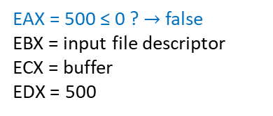
ToUpper main loop = read_loop_begin + continue_read_loop + end_loop
  ### BEGIN MAIN LOOP ###
read_loop_begin:
  ### READ IN A BLOCK FROM THE INPUT FILE ###
  movl $SYS_READ, %eax # read input file (syscall 3)
  movl ST_FD_IN(%ebp), %ebx # get input file descriptor
  movl $BUFFER_DATA, %ecx # location to read from
  movl $BUFFER_SIZE, %edx # size of buffer
  int $LINUX_SYSCALL # size of buffer read is
  # returned in %eax, returns
  # number of bytes actually read
  # or end-of-file (the number 0)
  ### EXIT IF WE’VE REACHED THE END ###
  cmpl $END_OF_FILE, %eax # check %eax for end-of-file marker
  jle end_loop # if found, or on error, go to the end
12(%ebp)$→$ | “output.txt”
8(%ebp)$→$ | "input.txt"
4(%ebp)$→$ | "toupper"
(%ebp)$→$ | 3
-4(%ebp)$→$ | input file descriptor
-8(%ebp) & (%esp)$→$ | output file descriptor
.equ END_OF_FILE, 0
.equ SYS_READ, 3
EAX = 500 ≤ 0 ? $→$ false
EBX = input file descriptor
ECX = buffer
EDX = 500

Slide 63
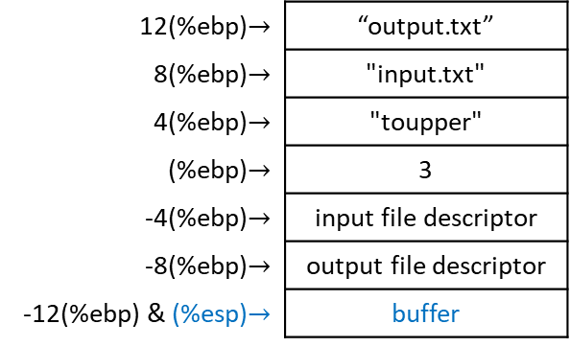
ToUpper main loop = read_loop_begin + continue_read_loop + end_loop
continue_read_loop:
  ### CONVERT THE BLOCK TO UPPER CASE ###
  pushl $BUFFER_DATA # location of buffer
  pushl %eax # size of buffer
  call convert_to_upper
  popl %eax # restore %eax register with
  # size of buffer
  addl $4, %esp # restore %esp
  ### WRITE THE BLOCK OUT TO THE OUTPUT FILE ###
  movl %eax, %edx # size of buffer
  movl $SYS_WRITE, %eax # issue a write system call
  movl ST_FD_OUT(%ebp), %ebx # file to write into
  movl $BUFFER_DATA, %ecx # location of buffer
  int $LINUX_SYSCALL
  ### CONTINUE THE LOOP ###
  jmp read_loop_begin
12(%ebp)$→$ | “output.txt”
8(%ebp)$→$ | "input.txt"
4(%ebp)$→$ | "toupper"
(%ebp)$→$ | 3
-4(%ebp)$→$ | input file descriptor
-8(%ebp)$→$ | output file descriptor
-12(%ebp) & (%esp)$→$ | buffer
.lcomm BUFFER_DATA, BUFFER_SIZE
.equ SYS_READ, 3
EAX = 500
EBX = input file descriptor
ECX = buffer
EDX = 500

Slide 64
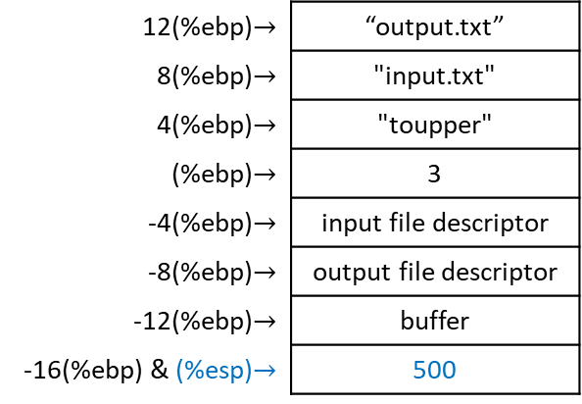
ToUpper main loop = read_loop_begin + continue_read_loop + end_loop
continue_read_loop:
  ### CONVERT THE BLOCK TO UPPER CASE ###
  pushl $BUFFER_DATA # location of buffer
  pushl %eax # size of buffer
  call convert_to_upper
  popl %eax # restore %eax register with
  # size of buffer
  addl $4, %esp # restore %esp
  ### WRITE THE BLOCK OUT TO THE OUTPUT FILE ###
  movl %eax, %edx # size of buffer
  movl $SYS_WRITE, %eax # issue a write system call
  movl ST_FD_OUT(%ebp), %ebx # file to write into
  movl $BUFFER_DATA, %ecx # location of buffer
  int $LINUX_SYSCALL
  ### CONTINUE THE LOOP ###
  jmp read_loop_begin
12(%ebp)$→$ | “output.txt”
8(%ebp)$→$ | "input.txt"
4(%ebp)$→$ | "toupper"
(%ebp)$→$ | 3
-4(%ebp)$→$ | input file descriptor
-8(%ebp)$→$ | output file descriptor
-12(%ebp)$→$ | buffer
-16(%ebp) & (%esp)$→$ | 500
.equ SYS_READ, 3
EAX = 500
EBX = input file descriptor
ECX = buffer
EDX = 500

Slide 65
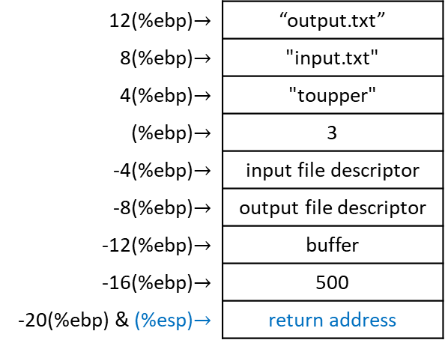
ToUpper main loop = read_loop_begin + continue_read_loop + end_loop
continue_read_loop:
  ### CONVERT THE BLOCK TO UPPER CASE ###
  pushl $BUFFER_DATA # location of buffer
  pushl %eax # size of buffer
  call convert_to_upper
  popl %eax # restore %eax register with
  # size of buffer
  addl $4, %esp # restore %esp
  ### WRITE THE BLOCK OUT TO THE OUTPUT FILE ###
  movl %eax, %edx # size of buffer
  movl $SYS_WRITE, %eax # issue a write system call
  movl ST_FD_OUT(%ebp), %ebx # file to write into
  movl $BUFFER_DATA, %ecx # location of buffer
  int $LINUX_SYSCALL
  ### CONTINUE THE LOOP ###
  jmp read_loop_begin
12(%ebp)$→$ | “output.txt”
8(%ebp)$→$ | "input.txt"
4(%ebp)$→$ | "toupper"
(%ebp)$→$ | 3
-4(%ebp)$→$ | input file descriptor
-8(%ebp)$→$ | output file descriptor
-12(%ebp)$→$ | buffer
-16(%ebp)$→$ | 500
-20(%ebp) & (%esp)$→$ | return address
EAX = 500
EBX = input file descriptor
ECX = buffer
EDX = 500
EIP = start of convert function

Slide 66
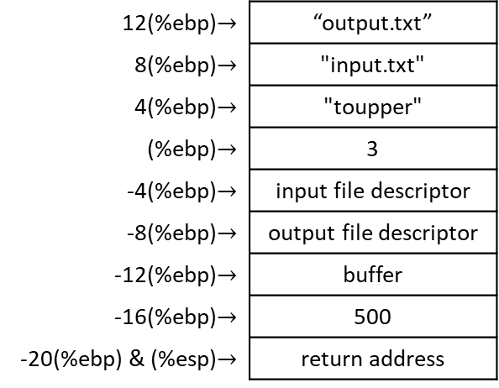
ToUpper continue_read_loop: convert_to_upper()
  ### CONSTANTS ###
  .equ LOWERCASE_A, 'a' # lower boundary of our search
  .equ LOWERCASE_A, 'z' # upper boundary of our search
  .equ UPPER_CONVERSION, 'A' – 'a' # 65 – 97 = -32
      # subtract 32 to a lowercase ASCII
      # letter to convert it to uppercase
  ### STACK STUFF ###
  .equ ST_BUFFER_LEN, 8 # length of buffer
  .equ ST_BUFFER, 12 # actual buffer
convert_to_upper:
  pushl %ebp # save old base pointer
  movl %esp, %ebp # make stack pointer the base pointer
  ### SET UP VARIABLES ###
  movl ST_BUFFER(%ebp), %eax # move the buffer into %eax
  movl ST_BUFFER_LEN(%ebp), %ebx # move the buffer length into %ebx
  movl $0, %edi # load zero into %edi to iterate
  # through each byte of the buffer
  cmpl $0, %ebx # sanity check: if buffer with
  # zero length was given,
  je end_convert_loop # just leave
12(%ebp)$→$ | “output.txt”
8(%ebp)$→$ | "input.txt"
4(%ebp)$→$ | "toupper"
(%ebp)$→$ | 3
-4(%ebp)$→$ | input file descriptor
-8(%ebp)$→$ | output file descriptor
-12(%ebp)$→$ | buffer
-16(%ebp)$→$ | 500
-20(%ebp) & (%esp)$→$ | return address
EAX = 500
EBX = input file descriptor
ECX = buffer
EDX = 500
EIP = start of convert function

Slide 67
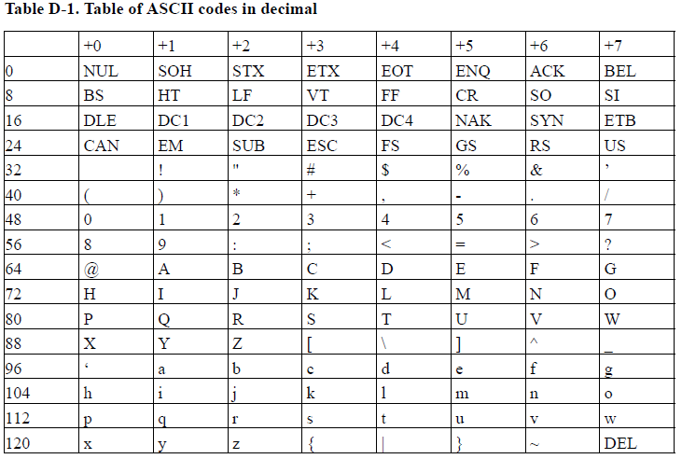
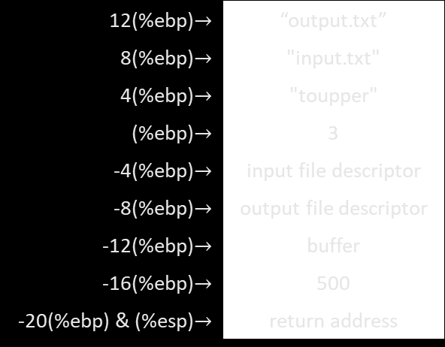
ToUpper continue_read_loop: convert_to_upper()
  ### CONSTANTS ###
  .equ LOWERCASE_A, 'a' # lower boundary of our search
  .equ LOWERCASE_A, 'z' # upper boundary of our search
  .equ UPPER_CONVERSION, 'A' – 'a' # 65 – 97 = -32
      # subtract 32 to a lowercase ASCII
      # letter to convert it to uppercase
  ### STACK STUFF ###
  .equ ST_BUFFER_LEN, 8 # length of buffer
  .equ ST_BUFFER, 12 # actual buffer
convert_to_upper:
  pushl %ebp # save old base pointer
  movl %esp, %ebp # make stack pointer the base pointer
  ### SET UP VARIABLES ###
  movl ST_BUFFER(%ebp), %eax # move the buffer into %eax
  movl ST_BUFFER_LEN(%ebp), %ebx # move the buffer length into %ebx
  movl $0, %edi # load zero into %edi to iterate
  # through each byte of the buffer
  cmpl $0, %ebx # sanity check: if buffer with
  # zero length was given,
  je end_convert_loop # just leave
12(%ebp)$→$ | “output.txt”
8(%ebp)$→$ | "input.txt"
4(%ebp)$→$ | "toupper"
(%ebp)$→$ | 3
-4(%ebp)$→$ | input file descriptor
-8(%ebp)$→$ | output file descriptor
-12(%ebp)$→$ | buffer
-16(%ebp)$→$ | 500
-20(%ebp) & (%esp)$→$ | return address
EAX = 500
EBX = input file descriptor
ECX = buffer
EDX = 500
EIP = start of convert function

Slide 68
ToUpper continue_read_loop: convert_to_upper()
  ### CONSTANTS ###
  .equ LOWERCASE_A, 'a' # lower boundary of our search
  .equ LOWERCASE_A, 'z' # upper boundary of our search
  .equ UPPER_CONVERSION, 'A' – 'a' # 65 – 97 = -32
      # subtract 32 to a lowercase ASCII
      # letter to convert it to uppercase
  ### STACK STUFF ###
  .equ ST_BUFFER_LEN, 8 # length of buffer
  .equ ST_BUFFER, 12 # actual buffer
convert_to_upper:
  pushl %ebp # save old base pointer
  movl %esp, %ebp # make stack pointer the base pointer
  ### SET UP VARIABLES ###
  movl ST_BUFFER(%ebp), %eax # move the buffer into %eax
  movl ST_BUFFER_LEN(%ebp), %ebx # move the buffer length into %ebx
  movl $0, %edi # load zero into %edi to iterate
  # through each byte of the buffer
  cmpl $0, %ebx # sanity check: if buffer with
  # zero length was given,
  je end_convert_loop # just leave
12(%ebp)$→$ | “output.txt”
8(%ebp)$→$ | "input.txt"
4(%ebp)$→$ | "toupper"
(%ebp)$→$ | 3
-4(%ebp)$→$ | input file descriptor
-8(%ebp)$→$ | output file descriptor
-12(%ebp)$→$ | buffer
-16(%ebp)$→$ | 500
-20(%ebp) & (%esp)$→$ | return address
EAX = 500
EBX = input file descriptor
ECX = buffer
EDX = 500
EIP = start of convert function

Slide 69
ToUpper continue_read_loop: convert_to_upper()
  ### CONSTANTS ###
  .equ LOWERCASE_A, 'a' # lower boundary of our search
  .equ LOWERCASE_A, 'z' # upper boundary of our search
  .equ UPPER_CONVERSION, 'A' – 'a' # 65 – 97 = -32
      # subtract 32 to a lowercase ASCII
      # letter to convert it to uppercase
  ### STACK STUFF ###
  .equ ST_BUFFER_LEN, 8 # length of buffer
  .equ ST_BUFFER, 12 # actual buffer
convert_to_upper:
  pushl %ebp # save old base pointer
  movl %esp, %ebp # make stack pointer the base pointer
  ### SET UP VARIABLES ###
  movl ST_BUFFER(%ebp), %eax # move the buffer into %eax
  movl ST_BUFFER_LEN(%ebp), %ebx # move the buffer length into %ebx
  movl $0, %edi # load zero into %edi to iterate
  # through each byte of the buffer
  cmpl $0, %ebx # sanity check: if buffer with
  # zero length was given,
  je end_convert_loop # just leave
12(%ebp)$→$ | “output.txt”
8(%ebp)$→$ | "input.txt"
4(%ebp)$→$ | "toupper"
(%ebp)$→$ | 3
-4(%ebp)$→$ | input file descriptor
-8(%ebp)$→$ | output file descriptor
-12(%ebp)$→$ | buffer
-16(%ebp)$→$ | 500
-20(%ebp) & (%esp)$→$ | return address
EAX = 500
EBX = input file descriptor
ECX = buffer
EDX = 500
EIP = start of convert function

Slide 70
ToUpper continue_read_loop: convert_to_upper()
  ### CONSTANTS ###
  .equ LOWERCASE_A, 'a' # lower boundary of our search
  .equ LOWERCASE_A, 'z' # upper boundary of our search
  .equ UPPER_CONVERSION, 'A' – 'a' # 65 – 97 = -32
      # subtract 32 to a lowercase ASCII
      # letter to convert it to uppercase
  ### STACK STUFF ###
  .equ ST_BUFFER_LEN, 8 # length of buffer
  .equ ST_BUFFER, 12 # actual buffer
convert_to_upper:
  pushl %ebp # save old base pointer
  movl %esp, %ebp # make stack pointer the base pointer
  ### SET UP VARIABLES ###
  movl ST_BUFFER(%ebp), %eax # move the buffer into %eax
  movl ST_BUFFER_LEN(%ebp), %ebx # move the buffer length into %ebx
  movl $0, %edi # load zero into %edi to iterate
  # through each byte of the buffer
  cmpl $0, %ebx # sanity check: if buffer with
  # zero length was given,
  je end_convert_loop # just leave
12(%ebp)$→$ | “output.txt”
8(%ebp)$→$ | "input.txt"
4(%ebp)$→$ | "toupper"
(%ebp)$→$ | 3
-4(%ebp)$→$ | input file descriptor
-8(%ebp)$→$ | output file descriptor
-12(%ebp)$→$ | buffer
-16(%ebp)$→$ | 500
-20(%ebp) & (%esp)$→$ | return address
EAX = 500
EBX = input file descriptor
ECX = buffer
EDX = 500
EIP = start of convert function
lower cases

Slide 71
ToUpper continue_read_loop: convert_to_upper()
  ### CONSTANTS ###
  .equ LOWERCASE_A, 'a' # lower boundary of our search
  .equ LOWERCASE_A, 'z' # upper boundary of our search
  .equ UPPER_CONVERSION, 'A' – 'a' # 65 – 97 = -32
      # subtract 32 to a lowercase ASCII
      # letter to convert it to uppercase
  ### STACK STUFF ###
  .equ ST_BUFFER_LEN, 8 # length of buffer
  .equ ST_BUFFER, 12 # actual buffer
convert_to_upper:
  pushl %ebp # save old base pointer
  movl %esp, %ebp # make stack pointer the base pointer
  ### SET UP VARIABLES ###
  movl ST_BUFFER(%ebp), %eax # move the buffer into %eax
  movl ST_BUFFER_LEN(%ebp), %ebx # move the buffer length into %ebx
  movl $0, %edi # load zero into %edi to iterate
  # through each byte of the buffer
  cmpl $0, %ebx # sanity check: if buffer with
  # zero length was given,
  je end_convert_loop # just leave
12(%ebp)$→$ | “output.txt”
8(%ebp)$→$ | "input.txt"
4(%ebp)$→$ | "toupper"
(%ebp)$→$ | 3
-4(%ebp)$→$ | input file descriptor
-8(%ebp)$→$ | output file descriptor
-12(%ebp)$→$ | buffer
-16(%ebp)$→$ | 500
-20(%ebp) & (%esp)$→$ | return address
EAX = 500
EBX = input file descriptor
ECX = buffer
EDX = 500
EIP = start of convert function
65
97

Slide 72
ToUpper continue_read_loop: convert_to_upper()
  ### CONSTANTS ###
  .equ LOWERCASE_A, 'a' # lower boundary of our search
  .equ LOWERCASE_A, 'z' # upper boundary of our search
  .equ UPPER_CONVERSION, 'A' – 'a' # 65 – 97 = -32
      # subtract 32 to a lowercase ASCII
      # letter to convert it to uppercase
  ### STACK STUFF ###
  .equ ST_BUFFER_LEN, 8 # length of buffer
  .equ ST_BUFFER, 12 # actual buffer
convert_to_upper:
  pushl %ebp # save old base pointer
  movl %esp, %ebp # make stack pointer the base pointer
  ### SET UP VARIABLES ###
  movl ST_BUFFER(%ebp), %eax # move the buffer into %eax
  movl ST_BUFFER_LEN(%ebp), %ebx # move the buffer length into %ebx
  movl $0, %edi # load zero into %edi to iterate
  # through each byte of the buffer
  cmpl $0, %ebx # sanity check: if buffer with
  # zero length was given,
  je end_convert_loop # just leave
12(%ebp)$→$ | “output.txt”
8(%ebp)$→$ | "input.txt"
4(%ebp)$→$ | "toupper"
(%ebp)$→$ | 3
-4(%ebp)$→$ | input file descriptor
-8(%ebp)$→$ | output file descriptor
-12(%ebp)$→$ | buffer
-16(%ebp)$→$ | 500
-20(%ebp) & (%esp)$→$ | return address
EAX = 500
EBX = input file descriptor
ECX = buffer
EDX = 500
EIP = start of convert function
65
-32
97

Slide 73
ToUpper continue_read_loop: convert_to_upper()
  ### CONSTANTS ###
  .equ LOWERCASE_A, 'a' # lower boundary of our search
  .equ LOWERCASE_A, 'z' # upper boundary of our search
  .equ UPPER_CONVERSION, 'A' – 'a' # 65 – 97 = -32
      # subtract 32 to a lowercase ASCII
      # letter to convert it to uppercase
  ### STACK STUFF ###
  .equ ST_BUFFER_LEN, 8 # length of buffer
  .equ ST_BUFFER, 12 # actual buffer
convert_to_upper:
  pushl %ebp # save old base pointer
  movl %esp, %ebp # make stack pointer the base pointer
  ### SET UP VARIABLES ###
  movl ST_BUFFER(%ebp), %eax # move the buffer into %eax
  movl ST_BUFFER_LEN(%ebp), %ebx # move the buffer length into %ebx
  movl $0, %edi # load zero into %edi to iterate
  # through each byte of the buffer
  cmpl $0, %ebx # sanity check: if buffer with
  # zero length was given,
  je end_convert_loop # just leave
12(%ebp)$→$ | “output.txt”
8(%ebp)$→$ | "input.txt"
4(%ebp)$→$ | "toupper"
(%ebp)$→$ | 3
-4(%ebp)$→$ | input file descriptor
-8(%ebp)$→$ | output file descriptor
-12(%ebp)$→$ | buffer
-16(%ebp)$→$ | 500
-20(%ebp) & (%esp)$→$ | return address
EAX = 500
EBX = input file descriptor
ECX = buffer
EDX = 500
EIP = start of convert function
65
-32
84
97
-32
116

Slide 74
ToUpper continue_read_loop: convert_to_upper()
  ### CONSTANTS ###
  .equ LOWERCASE_A, 'a' # lower boundary of our search
  .equ LOWERCASE_A, 'z' # upper boundary of our search
  .equ UPPER_CONVERSION, 'A' – 'a' # 65 – 97 = -32
      # subtract 32 to a lowercase ASCII
      # letter to convert it to uppercase
  ### STACK STUFF ###
  .equ ST_BUFFER_LEN, 8 # length of buffer
  .equ ST_BUFFER, 12 # actual buffer
convert_to_upper:
  pushl %ebp # save old base pointer
  movl %esp, %ebp # make stack pointer the base pointer
  ### SET UP VARIABLES ###
  movl ST_BUFFER(%ebp), %eax # move the buffer into %eax
  movl ST_BUFFER_LEN(%ebp), %ebx # move the buffer length into %ebx
  movl $0, %edi # load zero into %edi to iterate
  # through each byte of the buffer
  cmpl $0, %ebx # sanity check: if buffer with
  # zero length was given,
  je end_convert_loop # just leave
12(%ebp)$→$ | “output.txt”
8(%ebp)$→$ | "input.txt"
4(%ebp)$→$ | "toupper"
(%ebp)$→$ | 3
-4(%ebp)$→$ | input file descriptor
-8(%ebp)$→$ | output file descriptor
-12(%ebp)$→$ | buffer
-16(%ebp)$→$ | 500
-20(%ebp) & (%esp)$→$ | return address
EAX = 500
EBX = input file descriptor
ECX = buffer
EDX = 500
EIP = start of convert function

Slide 75
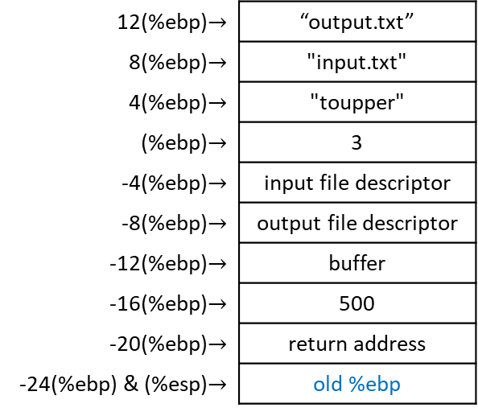
ToUpper continue_read_loop: convert_to_upper()
  ### CONSTANTS ###
  .equ LOWERCASE_A, 'a' # lower boundary of our search
  .equ LOWERCASE_A, 'z' # upper boundary of our search
  .equ UPPER_CONVERSION, 'A' – 'a' # 65 – 97 = -32
      # subtract 32 to a lowercase ASCII
      # letter to convert it to uppercase
  ### STACK STUFF ###
  .equ ST_BUFFER_LEN, 8 # length of buffer
  .equ ST_BUFFER, 12 # actual buffer
convert_to_upper:
  pushl %ebp # save old base pointer
  movl %esp, %ebp # make stack pointer the base pointer
  ### SET UP VARIABLES ###
  movl ST_BUFFER(%ebp), %eax # move the buffer into %eax
  movl ST_BUFFER_LEN(%ebp), %ebx # move the buffer length into %ebx
  movl $0, %edi # load zero into %edi to iterate
  # through each byte of the buffer
  cmpl $0, %ebx # sanity check: if buffer with
  # zero length was given,
  je end_convert_loop # just leave
12(%ebp)$→$ | “output.txt”
8(%ebp)$→$ | "input.txt"
4(%ebp)$→$ | "toupper"
(%ebp)$→$ | 3
-4(%ebp)$→$ | input file descriptor
-8(%ebp)$→$ | output file descriptor
-12(%ebp)$→$ | buffer
-16(%ebp)$→$ | 500
-20(%ebp)$→$ | return address
-24(%ebp) & (%esp)$→$ | old %ebp
EAX = 500
EBX = input file descriptor
ECX = buffer
EDX = 500
EIP = start of convert function

Slide 76
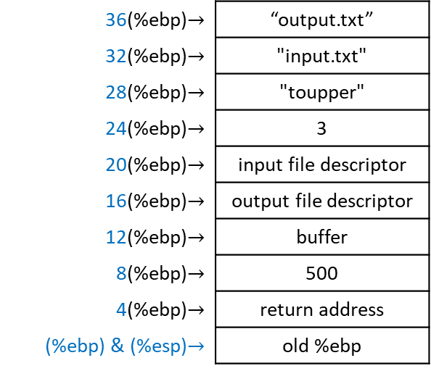
ToUpper continue_read_loop: convert_to_upper()
  ### CONSTANTS ###
  .equ LOWERCASE_A, 'a' # lower boundary of our search
  .equ LOWERCASE_A, 'z' # upper boundary of our search
  .equ UPPER_CONVERSION, 'A' – 'a' # 65 – 97 = -32
      # subtract 32 to a lowercase ASCII
      # letter to convert it to uppercase
  ### STACK STUFF ###
  .equ ST_BUFFER_LEN, 8 # length of buffer
  .equ ST_BUFFER, 12 # actual buffer
convert_to_upper:
  pushl %ebp # save old base pointer
  movl %esp, %ebp # make stack pointer the base pointer
  ### SET UP VARIABLES ###
  movl ST_BUFFER(%ebp), %eax # move the buffer into %eax
  movl ST_BUFFER_LEN(%ebp), %ebx # move the buffer length into %ebx
  movl $0, %edi # load zero into %edi to iterate
  # through each byte of the buffer
  cmpl $0, %ebx # sanity check: if buffer with
  # zero length was given,
  je end_convert_loop # just leave
36(%ebp)$→$ | “output.txt”
32(%ebp)$→$ | "input.txt"
28(%ebp)$→$ | "toupper"
24(%ebp)$→$ | 3
20(%ebp)$→$ | input file descriptor
16(%ebp)$→$ | output file descriptor
12(%ebp)$→$ | buffer
8(%ebp)$→$ | 500
4(%ebp)$→$ | return address
(%ebp) & (%esp)$→$ | old %ebp
EAX = 500
EBX = input file descriptor
ECX = buffer
EDX = 500
EIP = start of convert function

Slide 77
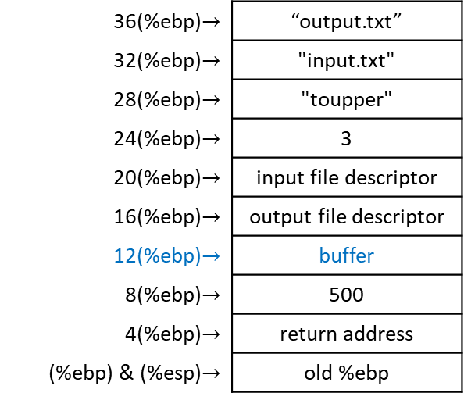
ToUpper continue_read_loop: convert_to_upper()
  ### CONSTANTS ###
  .equ LOWERCASE_A, 'a' # lower boundary of our search
  .equ LOWERCASE_A, 'z' # upper boundary of our search
  .equ UPPER_CONVERSION, 'A' – 'a' # 65 – 97 = -32
      # subtract 32 to a lowercase ASCII
      # letter to convert it to uppercase
  ### STACK STUFF ###
  .equ ST_BUFFER_LEN, 8 # length of buffer
  .equ ST_BUFFER, 12 # actual buffer
convert_to_upper:
  pushl %ebp # save old base pointer
  movl %esp, %ebp # make stack pointer the base pointer
  ### SET UP VARIABLES ###
  movl ST_BUFFER(%ebp), %eax # move the buffer into %eax
  movl ST_BUFFER_LEN(%ebp), %ebx # move the buffer length into %ebx
  movl $0, %edi # load zero into %edi to iterate
  # through each byte of the buffer
  cmpl $0, %ebx # sanity check: if buffer with
  # zero length was given,
  je end_convert_loop # just leave
36(%ebp)$→$ | “output.txt”
32(%ebp)$→$ | "input.txt"
28(%ebp)$→$ | "toupper"
24(%ebp)$→$ | 3
20(%ebp)$→$ | input file descriptor
16(%ebp)$→$ | output file descriptor
12(%ebp)$→$ | buffer
8(%ebp)$→$ | 500
4(%ebp)$→$ | return address
(%ebp) & (%esp)$→$ | old %ebp
EAX = buffer
EBX = input file descriptor
ECX = buffer
EDX = 500
EIP = start of convert function

Slide 78
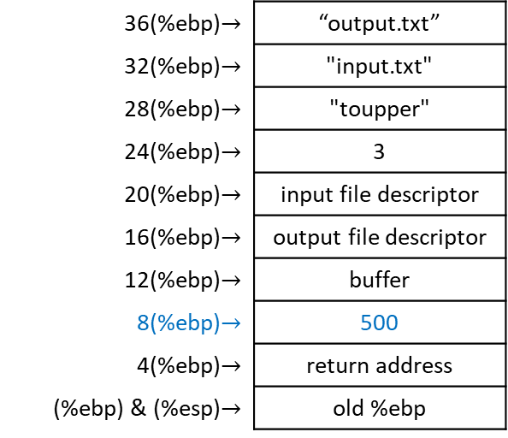
ToUpper continue_read_loop: convert_to_upper()
  ### CONSTANTS ###
  .equ LOWERCASE_A, 'a' # lower boundary of our search
  .equ LOWERCASE_A, 'z' # upper boundary of our search
  .equ UPPER_CONVERSION, 'A' – 'a' # 65 – 97 = -32
      # subtract 32 to a lowercase ASCII
      # letter to convert it to uppercase
  ### STACK STUFF ###
  .equ ST_BUFFER_LEN, 8 # length of buffer
  .equ ST_BUFFER, 12 # actual buffer
convert_to_upper:
  pushl %ebp # save old base pointer
  movl %esp, %ebp # make stack pointer the base pointer
  ### SET UP VARIABLES ###
  movl ST_BUFFER(%ebp), %eax # move the buffer into %eax
  movl ST_BUFFER_LEN(%ebp), %ebx # move the buffer length into %ebx
  movl $0, %edi # load zero into %edi to iterate
  # through each byte of the buffer
  cmpl $0, %ebx # sanity check: if buffer with
  # zero length was given,
  je end_convert_loop # just leave
36(%ebp)$→$ | “output.txt”
32(%ebp)$→$ | "input.txt"
28(%ebp)$→$ | "toupper"
24(%ebp)$→$ | 3
20(%ebp)$→$ | input file descriptor
16(%ebp)$→$ | output file descriptor
12(%ebp)$→$ | buffer
8(%ebp)$→$ | 500
4(%ebp)$→$ | return address
(%ebp) & (%esp)$→$ | old %ebp
EAX = buffer
EBX = 500
ECX = buffer
EDX = 500
EIP = start of convert function

Slide 79
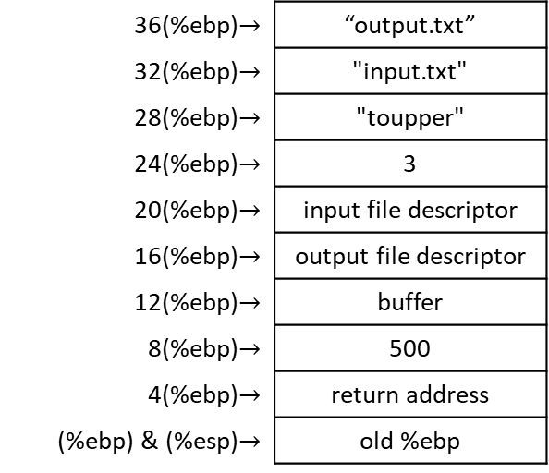
ToUpper continue_read_loop: convert_to_upper()
  ### CONSTANTS ###
  .equ LOWERCASE_A, 'a' # lower boundary of our search
  .equ LOWERCASE_A, 'z' # upper boundary of our search
  .equ UPPER_CONVERSION, 'A' – 'a' # 65 – 97 = -32
      # subtract 32 to a lowercase ASCII
      # letter to convert it to uppercase
  ### STACK STUFF ###
  .equ ST_BUFFER_LEN, 8 # length of buffer
  .equ ST_BUFFER, 12 # actual buffer
convert_to_upper:
  pushl %ebp # save old base pointer
  movl %esp, %ebp # make stack pointer the base pointer
  ### SET UP VARIABLES ###
  movl ST_BUFFER(%ebp), %eax # move the buffer into %eax
  movl ST_BUFFER_LEN(%ebp), %ebx # move the buffer length into %ebx
  movl $0, %edi # load zero into %edi to iterate
  # through each byte of the buffer
  cmpl $0, %ebx # sanity check: if buffer with
  # zero length was given,
  je end_convert_loop # just leave
36(%ebp)$→$ | “output.txt”
32(%ebp)$→$ | "input.txt"
28(%ebp)$→$ | "toupper"
24(%ebp)$→$ | 3
20(%ebp)$→$ | input file descriptor
16(%ebp)$→$ | output file descriptor
12(%ebp)$→$ | buffer
8(%ebp)$→$ | 500
4(%ebp)$→$ | return address
(%ebp) & (%esp)$→$ | old %ebp
EAX = buffer
EBX = 500
ECX = buffer
EDX = 500
EIP = start of convert function
EDI = 0

Slide 80
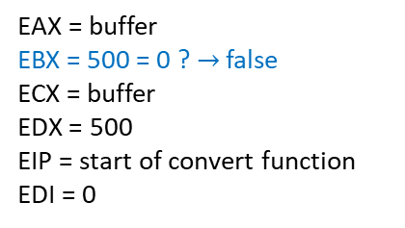
ToUpper continue_read_loop: convert_to_upper()
  ### CONSTANTS ###
  .equ LOWERCASE_A, 'a' # lower boundary of our search
  .equ LOWERCASE_A, 'z' # upper boundary of our search
  .equ UPPER_CONVERSION, 'A' – 'a' # 65 – 97 = -32
      # subtract 32 to a lowercase ASCII
      # letter to convert it to uppercase
  ### STACK STUFF ###
  .equ ST_BUFFER_LEN, 8 # length of buffer
  .equ ST_BUFFER, 12 # actual buffer
convert_to_upper:
  pushl %ebp # save old base pointer
  movl %esp, %ebp # make stack pointer the base pointer
  ### SET UP VARIABLES ###
  movl ST_BUFFER(%ebp), %eax # move the buffer into %eax
  movl ST_BUFFER_LEN(%ebp), %ebx # move the buffer length into %ebx
  movl $0, %edi # load zero into %edi to iterate
  # through each byte of the buffer
  cmpl $0, %ebx # sanity check: if buffer with
  # zero length was given,
  je end_convert_loop # just leave
36(%ebp)$→$ | “output.txt”
32(%ebp)$→$ | "input.txt"
28(%ebp)$→$ | "toupper"
24(%ebp)$→$ | 3
20(%ebp)$→$ | input file descriptor
16(%ebp)$→$ | output file descriptor
12(%ebp)$→$ | buffer
8(%ebp)$→$ | 500
4(%ebp)$→$ | return address
(%ebp) & (%esp)$→$ | old %ebp
EAX = buffer
EBX = 500 = 0 ? $→$ false
ECX = buffer
EDX = 500
EIP = start of convert function
EDI = 0

Slide 81

ToUpper continue_read_loop: convert_to_upper()
convert_loop:
  movb (%eax,%edi,1), %cl # get current byte by starting at %eax
  # and go %edi bytes forward, take that
  # value and put it in %cl
  # check if ‘a’ ≤ value ≤ ‘z’
  cmpb $LOWERCASE_A, %cl # smaller than ‘a’ isn’t lowercase
  jl next_byte # so jump to next byte
  cmpb $LOWERCASE_Z, %cl # greater than ‘z’ isn’t lowercase
  jg next_byte # so jump to next byte
  # otherwise convert byte to uppercase
  addb $UPPER_CONVERSION, %cl # add -32 to %cl
  movb %cl, (%eax,%edi,1) # and store it back
next_byte:
  incl %edi # next byte
  cmpl %edi, %ebx # are we at the end of the buffer?
  jne convert_loop # if not at the end, convert next value
end_convert_loop: # if at the end, finish (label not
# really necessary)
  movl %ebp, %esp # restore stack pointer
  popl %ebp # restore base pointer
  ret # popl %eip
36(%ebp)$→$ | “output.txt”
32(%ebp)$→$ | "input.txt"
28(%ebp)$→$ | "toupper"
24(%ebp)$→$ | 3
20(%ebp)$→$ | input file descriptor
16(%ebp)$→$ | output file descriptor
12(%ebp)$→$ | buffer
8(%ebp)$→$ | 500
4(%ebp)$→$ | return address
(%ebp) & (%esp)$→$ | old %ebp
EAX = buffer
EBX = 500
ECX = buffer
EDX = 500
EIP = start of convert function
EDI = 0
CL = h
%eax
$$↓$$
h F q B … N e x
0 1 2 3 … 497 498 499

Slide 82
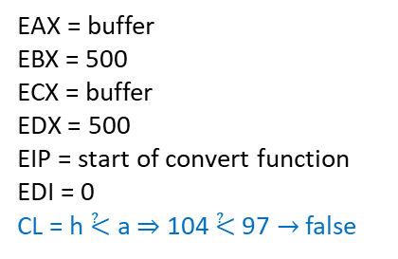
ToUpper continue_read_loop: convert_to_upper()
convert_loop:
  movb (%eax,%edi,1), %cl # get current byte by starting at %eax
  # and go %edi bytes forward, take that
  # value and put it in %cl
  # check if ‘a’ ≤ value ≤ ‘z’
  cmpb $LOWERCASE_A, %cl # smaller than ‘a’ isn’t lowercase
  jl next_byte # so jump to next byte
  cmpb $LOWERCASE_Z, %cl # greater than ‘z’ isn’t lowercase
  jg next_byte # so jump to next byte
  # otherwise convert byte to uppercase
  addb $UPPER_CONVERSION, %cl # add -32 to %cl
  movb %cl, (%eax,%edi,1) # and store it back
next_byte:
  incl %edi # next byte
  cmpl %edi, %ebx # are we at the end of the buffer?
  jne convert_loop # if not at the end, convert next value
end_convert_loop: # if at the end, finish (label not
# really necessary)
  movl %ebp, %esp # restore stack pointer
  popl %ebp # restore base pointer
  ret # popl %eip
36(%ebp)$→$ | “output.txt”
32(%ebp)$→$ | "input.txt"
28(%ebp)$→$ | "toupper"
24(%ebp)$→$ | 3
20(%ebp)$→$ | input file descriptor
16(%ebp)$→$ | output file descriptor
12(%ebp)$→$ | buffer
8(%ebp)$→$ | 500
4(%ebp)$→$ | return address
(%ebp) & (%esp)$→$ | old %ebp
EAX = buffer
EBX = 500
ECX = buffer
EDX = 500
EIP = start of convert function
EDI = 0
CL = h ⩻ a ⇒ 104 ⩻ 97 $→$ false
%eax
$$↓$$
h F q B … N e x
0 1 2 3 … 497 498 499

Slide 83
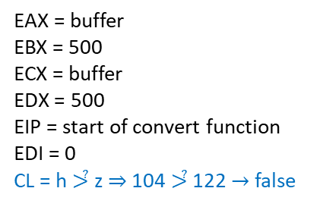
ToUpper continue_read_loop: convert_to_upper()
convert_loop:
  movb (%eax,%edi,1), %cl # get current byte by starting at %eax
  # and go %edi bytes forward, take that
  # value and put it in %cl
  # check if ‘a’ ≤ value ≤ ‘z’
  cmpb $LOWERCASE_A, %cl # smaller than ‘a’ isn’t lowercase
  jl next_byte # so jump to next byte
  cmpb $LOWERCASE_Z, %cl # greater than ‘z’ isn’t lowercase
  jg next_byte # so jump to next byte
  # otherwise convert byte to uppercase
  addb $UPPER_CONVERSION, %cl # add -32 to %cl
  movb %cl, (%eax,%edi,1) # and store it back
next_byte:
  incl %edi # next byte
  cmpl %edi, %ebx # are we at the end of the buffer?
  jne convert_loop # if not at the end, convert next value
end_convert_loop: # if at the end, finish (label not
# really necessary)
  movl %ebp, %esp # restore stack pointer
  popl %ebp # restore base pointer
  ret # popl %eip
36(%ebp)$→$ | “output.txt”
32(%ebp)$→$ | "input.txt"
28(%ebp)$→$ | "toupper"
24(%ebp)$→$ | 3
20(%ebp)$→$ | input file descriptor
16(%ebp)$→$ | output file descriptor
12(%ebp)$→$ | buffer
8(%ebp)$→$ | 500
4(%ebp)$→$ | return address
(%ebp) & (%esp)$→$ | old %ebp
EAX = buffer
EBX = 500
ECX = buffer
EDX = 500
EIP = start of convert function
EDI = 0
CL = h ⩼ z ⇒ 104 ⩼ 122 $→$ false
%eax
$$↓$$
h F q B … N e x
0 1 2 3 … 497 498 499

Slide 84
ToUpper continue_read_loop: convert_to_upper()
convert_loop:
  movb (%eax,%edi,1), %cl # get current byte by starting at %eax
  # and go %edi bytes forward, take that
  # value and put it in %cl
  # check if ‘a’ ≤ value ≤ ‘z’
  cmpb $LOWERCASE_A, %cl # smaller than ‘a’ isn’t lowercase
  jl next_byte # so jump to next byte
  cmpb $LOWERCASE_Z, %cl # greater than ‘z’ isn’t lowercase
  jg next_byte # so jump to next byte
  # otherwise convert byte to uppercase
  addb $UPPER_CONVERSION, %cl # add -32 to %cl
  movb %cl, (%eax,%edi,1) # and store it back
next_byte:
  incl %edi # next byte
  cmpl %edi, %ebx # are we at the end of the buffer?
  jne convert_loop # if not at the end, convert next value
end_convert_loop: # if at the end, finish (label not
# really necessary)
  movl %ebp, %esp # restore stack pointer
  popl %ebp # restore base pointer
  ret # popl %eip
36(%ebp)$→$ | “output.txt”
32(%ebp)$→$ | "input.txt"
28(%ebp)$→$ | "toupper"
24(%ebp)$→$ | 3
20(%ebp)$→$ | input file descriptor
16(%ebp)$→$ | output file descriptor
12(%ebp)$→$ | buffer
8(%ebp)$→$ | 500
4(%ebp)$→$ | return address
(%ebp) & (%esp)$→$ | old %ebp
EAX = buffer
EBX = 500
ECX = buffer
EDX = 500
EIP = start of convert function
EDI = 0
CL = h – 32 = 104 – 32 = 72 = H
%eax
$$↓$$
h F q B … N e x
0 1 2 3 … 497 498 499

Slide 85
ToUpper continue_read_loop: convert_to_upper()
convert_loop:
  movb (%eax,%edi,1), %cl # get current byte by starting at %eax
  # and go %edi bytes forward, take that
  # value and put it in %cl
  # check if ‘a’ ≤ value ≤ ‘z’
  cmpb $LOWERCASE_A, %cl # smaller than ‘a’ isn’t lowercase
  jl next_byte # so jump to next byte
  cmpb $LOWERCASE_Z, %cl # greater than ‘z’ isn’t lowercase
  jg next_byte # so jump to next byte
  # otherwise convert byte to uppercase
  addb $UPPER_CONVERSION, %cl # add -32 to %cl
  movb %cl, (%eax,%edi,1) # and store it back
next_byte:
  incl %edi # next byte
  cmpl %edi, %ebx # are we at the end of the buffer?
  jne convert_loop # if not at the end, convert next value
end_convert_loop: # if at the end, finish (label not
# really necessary)
  movl %ebp, %esp # restore stack pointer
  popl %ebp # restore base pointer
  ret # popl %eip
36(%ebp)$→$ | “output.txt”
32(%ebp)$→$ | "input.txt"
28(%ebp)$→$ | "toupper"
24(%ebp)$→$ | 3
20(%ebp)$→$ | input file descriptor
16(%ebp)$→$ | output file descriptor
12(%ebp)$→$ | buffer
8(%ebp)$→$ | 500
4(%ebp)$→$ | return address
(%ebp) & (%esp)$→$ | old %ebp
EAX = buffer
EBX = 500
ECX = buffer
EDX = 500
EIP = start of convert function
EDI = 0
CL = H
%eax
$$↓$$
H F q B … N e x
0 1 2 3 … 497 498 499

Slide 86
ToUpper continue_read_loop: convert_to_upper()
convert_loop:
  movb (%eax,%edi,1), %cl # get current byte by starting at %eax
  # and go %edi bytes forward, take that
  # value and put it in %cl
  # check if ‘a’ ≤ value ≤ ‘z’
  cmpb $LOWERCASE_A, %cl # smaller than ‘a’ isn’t lowercase
  jl next_byte # so jump to next byte
  cmpb $LOWERCASE_Z, %cl # greater than ‘z’ isn’t lowercase
  jg next_byte # so jump to next byte
  # otherwise convert byte to uppercase
  addb $UPPER_CONVERSION, %cl # add -32 to %cl
  movb %cl, (%eax,%edi,1) # and store it back
next_byte:
  incl %edi # next byte
  cmpl %edi, %ebx # are we at the end of the buffer?
  jne convert_loop # if not at the end, convert next value
end_convert_loop: # if at the end, finish (label not
# really necessary)
  movl %ebp, %esp # restore stack pointer
  popl %ebp # restore base pointer
  ret # popl %eip
36(%ebp)$→$ | “output.txt”
32(%ebp)$→$ | "input.txt"
28(%ebp)$→$ | "toupper"
24(%ebp)$→$ | 3
20(%ebp)$→$ | input file descriptor
16(%ebp)$→$ | output file descriptor
12(%ebp)$→$ | buffer
8(%ebp)$→$ | 500
4(%ebp)$→$ | return address
(%ebp) & (%esp)$→$ | old %ebp
EAX = buffer
EBX = 500
ECX = buffer
EDX = 500
EIP = start of convert function
EDI = 1
CL = H
%eax
$$↓$$
H F q B … N e x
0 1 2 3 … 497 498 499

Slide 87

ToUpper continue_read_loop: convert_to_upper()
convert_loop:
  movb (%eax,%edi,1), %cl # get current byte by starting at %eax
  # and go %edi bytes forward, take that
  # value and put it in %cl
  # check if ‘a’ ≤ value ≤ ‘z’
  cmpb $LOWERCASE_A, %cl # smaller than ‘a’ isn’t lowercase
  jl next_byte # so jump to next byte
  cmpb $LOWERCASE_Z, %cl # greater than ‘z’ isn’t lowercase
  jg next_byte # so jump to next byte
  # otherwise convert byte to uppercase
  addb $UPPER_CONVERSION, %cl # add -32 to %cl
  movb %cl, (%eax,%edi,1) # and store it back
next_byte:
  incl %edi # next byte
  cmpl %edi, %ebx # are we at the end of the buffer?
  jne convert_loop # if not at the end, convert next value
end_convert_loop: # if at the end, finish (label not
# really necessary)
  movl %ebp, %esp # restore stack pointer
  popl %ebp # restore base pointer
  ret # popl %eip
36(%ebp)$→$ | “output.txt”
32(%ebp)$→$ | "input.txt"
28(%ebp)$→$ | "toupper"
24(%ebp)$→$ | 3
20(%ebp)$→$ | input file descriptor
16(%ebp)$→$ | output file descriptor
12(%ebp)$→$ | buffer
8(%ebp)$→$ | 500
4(%ebp)$→$ | return address
(%ebp) & (%esp)$→$ | old %ebp
EAX = buffer
EBX = 500
ECX = buffer
EDX = 500
EIP = start of convert function
EDI = 1 ≠ 500 ? $→$ true
CL = H
%eax
$$↓$$
H F q B … N e x
0 1 2 3 … 497 498 499

Slide 88
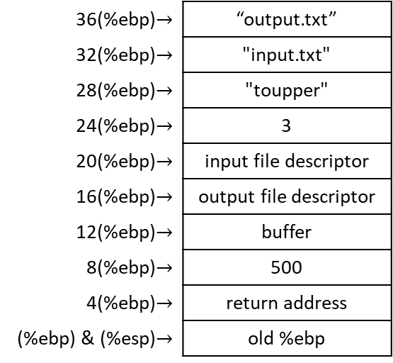
ToUpper continue_read_loop: convert_to_upper()
convert_loop:
  movb (%eax,%edi,1), %cl # get current byte by starting at %eax
  # and go %edi bytes forward, take that
  # value and put it in %cl
  # check if ‘a’ ≤ value ≤ ‘z’
  cmpb $LOWERCASE_A, %cl # smaller than ‘a’ isn’t lowercase
  jl next_byte # so jump to next byte
  cmpb $LOWERCASE_Z, %cl # greater than ‘z’ isn’t lowercase
  jg next_byte # so jump to next byte
  # otherwise convert byte to uppercase
  addb $UPPER_CONVERSION, %cl # add -32 to %cl
  movb %cl, (%eax,%edi,1) # and store it back
next_byte:
  incl %edi # next byte
  cmpl %edi, %ebx # are we at the end of the buffer?
  jne convert_loop # if not at the end, convert next value
end_convert_loop: # if at the end, finish (label not
# really necessary)
  movl %ebp, %esp # restore stack pointer
  popl %ebp # restore base pointer
  ret # popl %eip
36(%ebp)$→$ | “output.txt”
32(%ebp)$→$ | "input.txt"
28(%ebp)$→$ | "toupper"
24(%ebp)$→$ | 3
20(%ebp)$→$ | input file descriptor
16(%ebp)$→$ | output file descriptor
12(%ebp)$→$ | buffer
8(%ebp)$→$ | 500
4(%ebp)$→$ | return address
(%ebp) & (%esp)$→$ | old %ebp
EAX = buffer
EBX = 500
ECX = buffer
EDX = 500
EIP = start of convert function
EDI = 1
CL = H
%eax
$$↓$$
H F q B … N e x
0 1 2 3 … 497 498 499

Slide 89
ToUpper continue_read_loop: convert_to_upper()
convert_loop:
  movb (%eax,%edi,1), %cl # get current byte by starting at %eax
  # and go %edi bytes forward, take that
  # value and put it in %cl
  # check if ‘a’ ≤ value ≤ ‘z’
  cmpb $LOWERCASE_A, %cl # smaller than ‘a’ isn’t lowercase
  jl next_byte # so jump to next byte
  cmpb $LOWERCASE_Z, %cl # greater than ‘z’ isn’t lowercase
  jg next_byte # so jump to next byte
  # otherwise convert byte to uppercase
  addb $UPPER_CONVERSION, %cl # add -32 to %cl
  movb %cl, (%eax,%edi,1) # and store it back
next_byte:
  incl %edi # next byte
  cmpl %edi, %ebx # are we at the end of the buffer?
  jne convert_loop # if not at the end, convert next value
end_convert_loop: # if at the end, finish (label not
# really necessary)
  movl %ebp, %esp # restore stack pointer
  popl %ebp # restore base pointer
  ret # popl %eip
36(%ebp)$→$ | “output.txt”
32(%ebp)$→$ | "input.txt"
28(%ebp)$→$ | "toupper"
24(%ebp)$→$ | 3
20(%ebp)$→$ | input file descriptor
16(%ebp)$→$ | output file descriptor
12(%ebp)$→$ | buffer
8(%ebp)$→$ | 500
4(%ebp)$→$ | return address
(%ebp) & (%esp)$→$ | old %ebp
EAX = buffer
EBX = 500
ECX = buffer
EDX = 500
EIP = start of convert function
EDI = 1
CL = H
%eax
$$↓$$
H F q B … N e x
0 1 2 3 … 497 498 499

Slide 90
ToUpper continue_read_loop: convert_to_upper()
convert_loop:
  movb (%eax,%edi,1), %cl # get current byte by starting at %eax
  # and go %edi bytes forward, take that
  # value and put it in %cl
  # check if ‘a’ ≤ value ≤ ‘z’
  cmpb $LOWERCASE_A, %cl # smaller than ‘a’ isn’t lowercase
  jl next_byte # so jump to next byte
  cmpb $LOWERCASE_Z, %cl # greater than ‘z’ isn’t lowercase
  jg next_byte # so jump to next byte
  # otherwise convert byte to uppercase
  addb $UPPER_CONVERSION, %cl # add -32 to %cl
  movb %cl, (%eax,%edi,1) # and store it back
next_byte:
  incl %edi # next byte
  cmpl %edi, %ebx # are we at the end of the buffer?
  jne convert_loop # if not at the end, convert next value
end_convert_loop: # if at the end, finish (label not
# really necessary)
  movl %ebp, %esp # restore stack pointer
  popl %ebp # restore base pointer
  ret # popl %eip
36(%ebp)$→$ | “output.txt”
32(%ebp)$→$ | "input.txt"
28(%ebp)$→$ | "toupper"
24(%ebp)$→$ | 3
20(%ebp)$→$ | input file descriptor
16(%ebp)$→$ | output file descriptor
12(%ebp)$→$ | buffer
8(%ebp)$→$ | 500
4(%ebp)$→$ | return address
(%ebp) & (%esp)$→$ | old %ebp
EAX = buffer
EBX = 500
ECX = buffer
EDX = 500
EIP = start of convert function
EDI = 1
CL = F
%eax
$$↓$$
H F q B … N e x
0 1 2 3 … 497 498 499

Slide 91
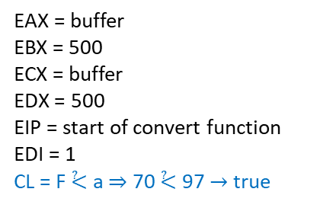
ToUpper continue_read_loop: convert_to_upper()
convert_loop:
  movb (%eax,%edi,1), %cl # get current byte by starting at %eax
  # and go %edi bytes forward, take that
  # value and put it in %cl
  # check if ‘a’ ≤ value ≤ ‘z’
  cmpb $LOWERCASE_A, %cl # smaller than ‘a’ isn’t lowercase
  jl next_byte # so jump to next byte
  cmpb $LOWERCASE_Z, %cl # greater than ‘z’ isn’t lowercase
  jg next_byte # so jump to next byte
  # otherwise convert byte to uppercase
  addb $UPPER_CONVERSION, %cl # add -32 to %cl
  movb %cl, (%eax,%edi,1) # and store it back
next_byte:
  incl %edi # next byte
  cmpl %edi, %ebx # are we at the end of the buffer?
  jne convert_loop # if not at the end, convert next value
end_convert_loop: # if at the end, finish (label not
# really necessary)
  movl %ebp, %esp # restore stack pointer
  popl %ebp # restore base pointer
  ret # popl %eip
36(%ebp)$→$ | “output.txt”
32(%ebp)$→$ | "input.txt"
28(%ebp)$→$ | "toupper"
24(%ebp)$→$ | 3
20(%ebp)$→$ | input file descriptor
16(%ebp)$→$ | output file descriptor
12(%ebp)$→$ | buffer
8(%ebp)$→$ | 500
4(%ebp)$→$ | return address
(%ebp) & (%esp)$→$ | old %ebp
EAX = buffer
EBX = 500
ECX = buffer
EDX = 500
EIP = start of convert function
EDI = 1
CL = F ⩻ a ⇒ 70 ⩻ 97 $→$ true
%eax
$$↓$$
H F q B … N e x
0 1 2 3 … 497 498 499

Slide 92
ToUpper continue_read_loop: convert_to_upper()
convert_loop:
  movb (%eax,%edi,1), %cl # get current byte by starting at %eax
  # and go %edi bytes forward, take that
  # value and put it in %cl
  # check if ‘a’ ≤ value ≤ ‘z’
  cmpb $LOWERCASE_A, %cl # smaller than ‘a’ isn’t lowercase
  jl next_byte # so jump to next byte
  cmpb $LOWERCASE_Z, %cl # greater than ‘z’ isn’t lowercase
  jg next_byte # so jump to next byte
  # otherwise convert byte to uppercase
  addb $UPPER_CONVERSION, %cl # add -32 to %cl
  movb %cl, (%eax,%edi,1) # and store it back
next_byte:
  incl %edi # next byte
  cmpl %edi, %ebx # are we at the end of the buffer?
  jne convert_loop # if not at the end, convert next value
end_convert_loop: # if at the end, finish (label not
# really necessary)
  movl %ebp, %esp # restore stack pointer
  popl %ebp # restore base pointer
  ret # popl %eip
36(%ebp)$→$ | “output.txt”
32(%ebp)$→$ | "input.txt"
28(%ebp)$→$ | "toupper"
24(%ebp)$→$ | 3
20(%ebp)$→$ | input file descriptor
16(%ebp)$→$ | output file descriptor
12(%ebp)$→$ | buffer
8(%ebp)$→$ | 500
4(%ebp)$→$ | return address
(%ebp) & (%esp)$→$ | old %ebp
EAX = buffer
EBX = 500
ECX = buffer
EDX = 500
EIP = start of convert function
EDI = 1
CL = F
%eax
$$↓$$
H F q B … N e x
0 1 2 3 … 497 498 499

Slide 93
ToUpper continue_read_loop: convert_to_upper()
convert_loop:
  movb (%eax,%edi,1), %cl # get current byte by starting at %eax
  # and go %edi bytes forward, take that
  # value and put it in %cl
  # check if ‘a’ ≤ value ≤ ‘z’
  cmpb $LOWERCASE_A, %cl # smaller than ‘a’ isn’t lowercase
  jl next_byte # so jump to next byte
  cmpb $LOWERCASE_Z, %cl # greater than ‘z’ isn’t lowercase
  jg next_byte # so jump to next byte
  # otherwise convert byte to uppercase
  addb $UPPER_CONVERSION, %cl # add -32 to %cl
  movb %cl, (%eax,%edi,1) # and store it back
next_byte:
  incl %edi # next byte
  cmpl %edi, %ebx # are we at the end of the buffer?
  jne convert_loop # if not at the end, convert next value
end_convert_loop: # if at the end, finish (label not
# really necessary)
  movl %ebp, %esp # restore stack pointer
  popl %ebp # restore base pointer
  ret # popl %eip
36(%ebp)$→$ | “output.txt”
32(%ebp)$→$ | "input.txt"
28(%ebp)$→$ | "toupper"
24(%ebp)$→$ | 3
20(%ebp)$→$ | input file descriptor
16(%ebp)$→$ | output file descriptor
12(%ebp)$→$ | buffer
8(%ebp)$→$ | 500
4(%ebp)$→$ | return address
(%ebp) & (%esp)$→$ | old %ebp
EAX = buffer
EBX = 500
ECX = buffer
EDX = 500
EIP = start of convert function
EDI = 1
CL = F
%eax
$$↓$$
H F q B … N e x
0 1 2 3 … 497 498 499

Slide 94
ToUpper continue_read_loop: convert_to_upper()
convert_loop:
  movb (%eax,%edi,1), %cl # get current byte by starting at %eax
  # and go %edi bytes forward, take that
  # value and put it in %cl
  # check if ‘a’ ≤ value ≤ ‘z’
  cmpb $LOWERCASE_A, %cl # smaller than ‘a’ isn’t lowercase
  jl next_byte # so jump to next byte
  cmpb $LOWERCASE_Z, %cl # greater than ‘z’ isn’t lowercase
  jg next_byte # so jump to next byte
  # otherwise convert byte to uppercase
  addb $UPPER_CONVERSION, %cl # add -32 to %cl
  movb %cl, (%eax,%edi,1) # and store it back
next_byte:
  incl %edi # next byte
  cmpl %edi, %ebx # are we at the end of the buffer?
  jne convert_loop # if not at the end, convert next value
end_convert_loop: # if at the end, finish (label not
# really necessary)
  movl %ebp, %esp # restore stack pointer
  popl %ebp # restore base pointer
  ret # popl %eip
36(%ebp)$→$ | “output.txt”
32(%ebp)$→$ | "input.txt"
28(%ebp)$→$ | "toupper"
24(%ebp)$→$ | 3
20(%ebp)$→$ | input file descriptor
16(%ebp)$→$ | output file descriptor
12(%ebp)$→$ | buffer
8(%ebp)$→$ | 500
4(%ebp)$→$ | return address
(%ebp) & (%esp)$→$ | old %ebp
EAX = buffer
EBX = 500
ECX = buffer
EDX = 500
EIP = start of convert function
EDI = 2
CL = F
%eax
$$↓$$
H F q B … N e x
0 1 2 3 … 497 498 499

Slide 95

ToUpper continue_read_loop: convert_to_upper()
convert_loop:
  movb (%eax,%edi,1), %cl # get current byte by starting at %eax
  # and go %edi bytes forward, take that
  # value and put it in %cl
  # check if ‘a’ ≤ value ≤ ‘z’
  cmpb $LOWERCASE_A, %cl # smaller than ‘a’ isn’t lowercase
  jl next_byte # so jump to next byte
  cmpb $LOWERCASE_Z, %cl # greater than ‘z’ isn’t lowercase
  jg next_byte # so jump to next byte
  # otherwise convert byte to uppercase
  addb $UPPER_CONVERSION, %cl # add -32 to %cl
  movb %cl, (%eax,%edi,1) # and store it back
next_byte:
  incl %edi # next byte
  cmpl %edi, %ebx # are we at the end of the buffer?
  jne convert_loop # if not at the end, convert next value
end_convert_loop: # if at the end, finish (label not
# really necessary)
  movl %ebp, %esp # restore stack pointer
  popl %ebp # restore base pointer
  ret # popl %eip
36(%ebp)$→$ | “output.txt”
32(%ebp)$→$ | "input.txt"
28(%ebp)$→$ | "toupper"
24(%ebp)$→$ | 3
20(%ebp)$→$ | input file descriptor
16(%ebp)$→$ | output file descriptor
12(%ebp)$→$ | buffer
8(%ebp)$→$ | 500
4(%ebp)$→$ | return address
(%ebp) & (%esp)$→$ | old %ebp
EAX = buffer
EBX = 500
ECX = buffer
EDX = 500
EIP = start of convert function
EDI = 2 ≠ 500 ? $→$ true
CL = F
%eax
$$↓$$
H F q B … N e x
0 1 2 3 … 497 498 499

Slide 96
ToUpper continue_read_loop: convert_to_upper()
convert_loop:
  movb (%eax,%edi,1), %cl # get current byte by starting at %eax
  # and go %edi bytes forward, take that
  # value and put it in %cl
  # check if ‘a’ ≤ value ≤ ‘z’
  cmpb $LOWERCASE_A, %cl # smaller than ‘a’ isn’t lowercase
  jl next_byte # so jump to next byte
  cmpb $LOWERCASE_Z, %cl # greater than ‘z’ isn’t lowercase
  jg next_byte # so jump to next byte
  # otherwise convert byte to uppercase
  addb $UPPER_CONVERSION, %cl # add -32 to %cl
  movb %cl, (%eax,%edi,1) # and store it back
next_byte:
  incl %edi # next byte
  cmpl %edi, %ebx # are we at the end of the buffer?
  jne convert_loop # if not at the end, convert next value
end_convert_loop: # if at the end, finish (label not
# really necessary)
  movl %ebp, %esp # restore stack pointer
  popl %ebp # restore base pointer
  ret # popl %eip
36(%ebp)$→$ | “output.txt”
32(%ebp)$→$ | "input.txt"
28(%ebp)$→$ | "toupper"
24(%ebp)$→$ | 3
20(%ebp)$→$ | input file descriptor
16(%ebp)$→$ | output file descriptor
12(%ebp)$→$ | buffer
8(%ebp)$→$ | 500
4(%ebp)$→$ | return address
(%ebp) & (%esp)$→$ | old %ebp
EAX = buffer
EBX = 500
ECX = buffer
EDX = 500
EIP = start of convert function
EDI = 2
CL = F
%eax
$$↓$$
H F q B … N e x
0 1 2 3 … 497 498 499

Slide 97
ToUpper continue_read_loop: convert_to_upper()
convert_loop:
  movb (%eax,%edi,1), %cl # get current byte by starting at %eax
  # and go %edi bytes forward, take that
  # value and put it in %cl
  # check if ‘a’ ≤ value ≤ ‘z’
  cmpb $LOWERCASE_A, %cl # smaller than ‘a’ isn’t lowercase
  jl next_byte # so jump to next byte
  cmpb $LOWERCASE_Z, %cl # greater than ‘z’ isn’t lowercase
  jg next_byte # so jump to next byte
  # otherwise convert byte to uppercase
  addb $UPPER_CONVERSION, %cl # add -32 to %cl
  movb %cl, (%eax,%edi,1) # and store it back
next_byte:
  incl %edi # next byte
  cmpl %edi, %ebx # are we at the end of the buffer?
  jne convert_loop # if not at the end, convert next value
end_convert_loop: # if at the end, finish (label not
# really necessary)
  movl %ebp, %esp # restore stack pointer
  popl %ebp # restore base pointer
  ret # popl %eip
36(%ebp)$→$ | “output.txt”
32(%ebp)$→$ | "input.txt"
28(%ebp)$→$ | "toupper"
24(%ebp)$→$ | 3
20(%ebp)$→$ | input file descriptor
16(%ebp)$→$ | output file descriptor
12(%ebp)$→$ | buffer
8(%ebp)$→$ | 500
4(%ebp)$→$ | return address
(%ebp) & (%esp)$→$ | old %ebp
ETC…
Iterating through all 500 bytes of the buffer…
EAX = buffer
EBX = 500
ECX = buffer
EDX = 500
EIP = start of convert function
EDI = (0 – 499)
CL = F
%eax
$$↓$$
H F q B … N e x
0 1 2 3 … 497 498 499

Slide 98
ToUpper continue_read_loop: convert_to_upper()
convert_loop:
  movb (%eax,%edi,1), %cl # get current byte by starting at %eax
  # and go %edi bytes forward, take that
  # value and put it in %cl
  # check if ‘a’ ≤ value ≤ ‘z’
  cmpb $LOWERCASE_A, %cl # smaller than ‘a’ isn’t lowercase
  jl next_byte # so jump to next byte
  cmpb $LOWERCASE_Z, %cl # greater than ‘z’ isn’t lowercase
  jg next_byte # so jump to next byte
  # otherwise convert byte to uppercase
  addb $UPPER_CONVERSION, %cl # add -32 to %cl
  movb %cl, (%eax,%edi,1) # and store it back
next_byte:
  incl %edi # next byte
  cmpl %edi, %ebx # are we at the end of the buffer?
  jne convert_loop # if not at the end, convert next value
end_convert_loop: # if at the end, finish (label not
# really necessary)
  movl %ebp, %esp # restore stack pointer
  popl %ebp # restore base pointer
  ret # popl %eip
36(%ebp)$→$ | “output.txt”
32(%ebp)$→$ | "input.txt"
28(%ebp)$→$ | "toupper"
24(%ebp)$→$ | 3
20(%ebp)$→$ | input file descriptor
16(%ebp)$→$ | output file descriptor
12(%ebp)$→$ | buffer
8(%ebp)$→$ | 500
4(%ebp)$→$ | return address
(%ebp) & (%esp)$→$ | old %ebp
ETC…
…until the last byte of the first buffer.
EAX = buffer
EBX = 500
ECX = buffer
EDX = 500
EIP = start of convert function
EDI = 499
CL = F
%eax
$$↓$$
H F q B … N e x
0 1 2 3 … 497 498 499

Slide 99
ToUpper continue_read_loop: convert_to_upper()
convert_loop:
  movb (%eax,%edi,1), %cl # get current byte by starting at %eax
  # and go %edi bytes forward, take that
  # value and put it in %cl
  # check if ‘a’ ≤ value ≤ ‘z’
  cmpb $LOWERCASE_A, %cl # smaller than ‘a’ isn’t lowercase
  jl next_byte # so jump to next byte
  cmpb $LOWERCASE_Z, %cl # greater than ‘z’ isn’t lowercase
  jg next_byte # so jump to next byte
  # otherwise convert byte to uppercase
  addb $UPPER_CONVERSION, %cl # add -32 to %cl
  movb %cl, (%eax,%edi,1) # and store it back
next_byte:
  incl %edi # next byte
  cmpl %edi, %ebx # are we at the end of the buffer?
  jne convert_loop # if not at the end, convert next value
end_convert_loop: # if at the end, finish (label not
# really necessary)
  movl %ebp, %esp # restore stack pointer
  popl %ebp # restore base pointer
  ret # popl %eip
36(%ebp)$→$ | “output.txt”
32(%ebp)$→$ | "input.txt"
28(%ebp)$→$ | "toupper"
24(%ebp)$→$ | 3
20(%ebp)$→$ | input file descriptor
16(%ebp)$→$ | output file descriptor
12(%ebp)$→$ | buffer
8(%ebp)$→$ | 500
4(%ebp)$→$ | return address
(%ebp) & (%esp)$→$ | old %ebp
EAX = buffer
EBX = 500
ECX = buffer
EDX = 500
EIP = start of convert function
EDI = 499
CL = F
%eax
$$↓$$
H F q B … N e x
0 1 2 3 … 497 498 499

Slide 100
ToUpper continue_read_loop: convert_to_upper()
convert_loop:
  movb (%eax,%edi,1), %cl # get current byte by starting at %eax
  # and go %edi bytes forward, take that
  # value and put it in %cl
  # check if ‘a’ ≤ value ≤ ‘z’
  cmpb $LOWERCASE_A, %cl # smaller than ‘a’ isn’t lowercase
  jl next_byte # so jump to next byte
  cmpb $LOWERCASE_Z, %cl # greater than ‘z’ isn’t lowercase
  jg next_byte # so jump to next byte
  # otherwise convert byte to uppercase
  addb $UPPER_CONVERSION, %cl # add -32 to %cl
  movb %cl, (%eax,%edi,1) # and store it back
next_byte:
  incl %edi # next byte
  cmpl %edi, %ebx # are we at the end of the buffer?
  jne convert_loop # if not at the end, convert next value
end_convert_loop: # if at the end, finish (label not
# really necessary)
  movl %ebp, %esp # restore stack pointer
  popl %ebp # restore base pointer
  ret # popl %eip
36(%ebp)$→$ | “output.txt”
32(%ebp)$→$ | "input.txt"
28(%ebp)$→$ | "toupper"
24(%ebp)$→$ | 3
20(%ebp)$→$ | input file descriptor
16(%ebp)$→$ | output file descriptor
12(%ebp)$→$ | buffer
8(%ebp)$→$ | 500
4(%ebp)$→$ | return address
(%ebp) & (%esp)$→$ | old %ebp
EAX = buffer
EBX = 500
ECX = buffer
EDX = 500
EIP = start of convert function
EDI = 499
CL = x
%eax
$$↓$$
H F q B … N e x
0 1 2 3 … 497 498 499

Slide 101
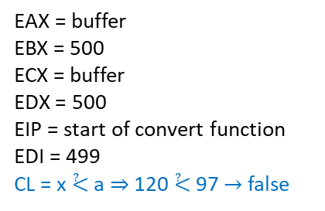
ToUpper continue_read_loop: convert_to_upper()
convert_loop:
  movb (%eax,%edi,1), %cl # get current byte by starting at %eax
  # and go %edi bytes forward, take that
  # value and put it in %cl
  # check if ‘a’ ≤ value ≤ ‘z’
  cmpb $LOWERCASE_A, %cl # smaller than ‘a’ isn’t lowercase
  jl next_byte # so jump to next byte
  cmpb $LOWERCASE_Z, %cl # greater than ‘z’ isn’t lowercase
  jg next_byte # so jump to next byte
  # otherwise convert byte to uppercase
  addb $UPPER_CONVERSION, %cl # add -32 to %cl
  movb %cl, (%eax,%edi,1) # and store it back
next_byte:
  incl %edi # next byte
  cmpl %edi, %ebx # are we at the end of the buffer?
  jne convert_loop # if not at the end, convert next value
end_convert_loop: # if at the end, finish (label not
# really necessary)
  movl %ebp, %esp # restore stack pointer
  popl %ebp # restore base pointer
  ret # popl %eip
36(%ebp)$→$ | “output.txt”
32(%ebp)$→$ | "input.txt"
28(%ebp)$→$ | "toupper"
24(%ebp)$→$ | 3
20(%ebp)$→$ | input file descriptor
16(%ebp)$→$ | output file descriptor
12(%ebp)$→$ | buffer
8(%ebp)$→$ | 500
4(%ebp)$→$ | return address
(%ebp) & (%esp)$→$ | old %ebp
EAX = buffer
EBX = 500
ECX = buffer
EDX = 500
EIP = start of convert function
EDI = 499
CL = x ⩻ a ⇒ 120 ⩻ 97 $→$ false
%eax
$$↓$$
H F q B … N e x
0 1 2 3 … 497 498 499

Slide 102
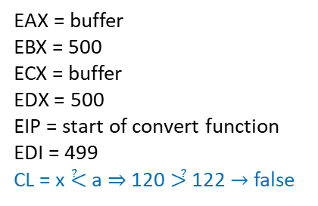
ToUpper continue_read_loop: convert_to_upper()
convert_loop:
  movb (%eax,%edi,1), %cl # get current byte by starting at %eax
  # and go %edi bytes forward, take that
  # value and put it in %cl
  # check if ‘a’ ≤ value ≤ ‘z’
  cmpb $LOWERCASE_A, %cl # smaller than ‘a’ isn’t lowercase
  jl next_byte # so jump to next byte
  cmpb $LOWERCASE_Z, %cl # greater than ‘z’ isn’t lowercase
  jg next_byte # so jump to next byte
  # otherwise convert byte to uppercase
  addb $UPPER_CONVERSION, %cl # add -32 to %cl
  movb %cl, (%eax,%edi,1) # and store it back
next_byte:
  incl %edi # next byte
  cmpl %edi, %ebx # are we at the end of the buffer?
  jne convert_loop # if not at the end, convert next value
end_convert_loop: # if at the end, finish (label not
# really necessary)
  movl %ebp, %esp # restore stack pointer
  popl %ebp # restore base pointer
  ret # popl %eip
36(%ebp)$→$ | “output.txt”
32(%ebp)$→$ | "input.txt"
28(%ebp)$→$ | "toupper"
24(%ebp)$→$ | 3
20(%ebp)$→$ | input file descriptor
16(%ebp)$→$ | output file descriptor
12(%ebp)$→$ | buffer
8(%ebp)$→$ | 500
4(%ebp)$→$ | return address
(%ebp) & (%esp)$→$ | old %ebp
EAX = buffer
EBX = 500
ECX = buffer
EDX = 500
EIP = start of convert function
EDI = 499
CL = x ⩻ a ⇒ 120 ⩼ 122 $→$ false
%eax
$$↓$$
H F q B … N e x
0 1 2 3 … 497 498 499

Slide 103
ToUpper continue_read_loop: convert_to_upper()
convert_loop:
  movb (%eax,%edi,1), %cl # get current byte by starting at %eax
  # and go %edi bytes forward, take that
  # value and put it in %cl
  # check if ‘a’ ≤ value ≤ ‘z’
  cmpb $LOWERCASE_A, %cl # smaller than ‘a’ isn’t lowercase
  jl next_byte # so jump to next byte
  cmpb $LOWERCASE_Z, %cl # greater than ‘z’ isn’t lowercase
  jg next_byte # so jump to next byte
  # otherwise convert byte to uppercase
  addb $UPPER_CONVERSION, %cl # add -32 to %cl
  movb %cl, (%eax,%edi,1) # and store it back
next_byte:
  incl %edi # next byte
  cmpl %edi, %ebx # are we at the end of the buffer?
  jne convert_loop # if not at the end, convert next value
end_convert_loop: # if at the end, finish (label not
# really necessary)
  movl %ebp, %esp # restore stack pointer
  popl %ebp # restore base pointer
  ret # popl %eip
36(%ebp)$→$ | “output.txt”
32(%ebp)$→$ | "input.txt"
28(%ebp)$→$ | "toupper"
24(%ebp)$→$ | 3
20(%ebp)$→$ | input file descriptor
16(%ebp)$→$ | output file descriptor
12(%ebp)$→$ | buffer
8(%ebp)$→$ | 500
4(%ebp)$→$ | return address
(%ebp) & (%esp)$→$ | old %ebp
EAX = buffer
EBX = 500
ECX = buffer
EDX = 500
EIP = start of convert function
EDI = 499
CL = x – 32 = 120 – 32 = 88 = X
%eax
$$↓$$
H F q B … N e x
0 1 2 3 … 497 498 499

Slide 104
ToUpper continue_read_loop: convert_to_upper()
convert_loop:
  movb (%eax,%edi,1), %cl # get current byte by starting at %eax
  # and go %edi bytes forward, take that
  # value and put it in %cl
  # check if ‘a’ ≤ value ≤ ‘z’
  cmpb $LOWERCASE_A, %cl # smaller than ‘a’ isn’t lowercase
  jl next_byte # so jump to next byte
  cmpb $LOWERCASE_Z, %cl # greater than ‘z’ isn’t lowercase
  jg next_byte # so jump to next byte
  # otherwise convert byte to uppercase
  addb $UPPER_CONVERSION, %cl # add -32 to %cl
  movb %cl, (%eax,%edi,1) # and store it back
next_byte:
  incl %edi # next byte
  cmpl %edi, %ebx # are we at the end of the buffer?
  jne convert_loop # if not at the end, convert next value
end_convert_loop: # if at the end, finish (label not
# really necessary)
  movl %ebp, %esp # restore stack pointer
  popl %ebp # restore base pointer
  ret # popl %eip
36(%ebp)$→$ | “output.txt”
32(%ebp)$→$ | "input.txt"
28(%ebp)$→$ | "toupper"
24(%ebp)$→$ | 3
20(%ebp)$→$ | input file descriptor
16(%ebp)$→$ | output file descriptor
12(%ebp)$→$ | buffer
8(%ebp)$→$ | 500
4(%ebp)$→$ | return address
(%ebp) & (%esp)$→$ | old %ebp
EAX = buffer
EBX = 500
ECX = buffer
EDX = 500
EIP = start of convert function
EDI = 499
CL = X
%eax
$$↓$$
H F q B … N e x
0 1 2 3 … 497 498 499

Slide 105
ToUpper continue_read_loop: convert_to_upper()
convert_loop:
  movb (%eax,%edi,1), %cl # get current byte by starting at %eax
  # and go %edi bytes forward, take that
  # value and put it in %cl
  # check if ‘a’ ≤ value ≤ ‘z’
  cmpb $LOWERCASE_A, %cl # smaller than ‘a’ isn’t lowercase
  jl next_byte # so jump to next byte
  cmpb $LOWERCASE_Z, %cl # greater than ‘z’ isn’t lowercase
  jg next_byte # so jump to next byte
  # otherwise convert byte to uppercase
  addb $UPPER_CONVERSION, %cl # add -32 to %cl
  movb %cl, (%eax,%edi,1) # and store it back
next_byte:
  incl %edi # next byte
  cmpl %edi, %ebx # are we at the end of the buffer?
  jne convert_loop # if not at the end, convert next value
end_convert_loop: # if at the end, finish (label not
# really necessary)
  movl %ebp, %esp # restore stack pointer
  popl %ebp # restore base pointer
  ret # popl %eip
36(%ebp)$→$ | “output.txt”
32(%ebp)$→$ | "input.txt"
28(%ebp)$→$ | "toupper"
24(%ebp)$→$ | 3
20(%ebp)$→$ | input file descriptor
16(%ebp)$→$ | output file descriptor
12(%ebp)$→$ | buffer
8(%ebp)$→$ | 500
4(%ebp)$→$ | return address
(%ebp) & (%esp)$→$ | old %ebp
EAX = buffer
EBX = 500
ECX = buffer
EDX = 500
EIP = start of convert function
EDI = 500
CL = X
%eax
$$↓$$
H F q B … N e x
0 1 2 3 … 497 498 499

Slide 106

ToUpper continue_read_loop: convert_to_upper()
convert_loop:
  movb (%eax,%edi,1), %cl # get current byte by starting at %eax
  # and go %edi bytes forward, take that
  # value and put it in %cl
  # check if ‘a’ ≤ value ≤ ‘z’
  cmpb $LOWERCASE_A, %cl # smaller than ‘a’ isn’t lowercase
  jl next_byte # so jump to next byte
  cmpb $LOWERCASE_Z, %cl # greater than ‘z’ isn’t lowercase
  jg next_byte # so jump to next byte
  # otherwise convert byte to uppercase
  addb $UPPER_CONVERSION, %cl # add -32 to %cl
  movb %cl, (%eax,%edi,1) # and store it back
next_byte:
  incl %edi # next byte
  cmpl %edi, %ebx # are we at the end of the buffer?
  jne convert_loop # if not at the end, convert next value
end_convert_loop: # if at the end, finish (label not
# really necessary)
  movl %ebp, %esp # restore stack pointer
  popl %ebp # restore base pointer
  ret # popl %eip
36(%ebp)$→$ | “output.txt”
32(%ebp)$→$ | "input.txt"
28(%ebp)$→$ | "toupper"
24(%ebp)$→$ | 3
20(%ebp)$→$ | input file descriptor
16(%ebp)$→$ | output file descriptor
12(%ebp)$→$ | buffer
8(%ebp)$→$ | 500
4(%ebp)$→$ | return address
(%ebp) & (%esp)$→$ | old %ebp
EAX = buffer
EBX = 500
ECX = buffer
EDX = 500
EIP = start of convert function
EDI = 500 ≠ 500 ? $→$ false
CL = X
%eax
$$↓$$
H F q B … N e x
0 1 2 3 … 497 498 499

Slide 107
ToUpper continue_read_loop: convert_to_upper()
convert_loop:
  movb (%eax,%edi,1), %cl # get current byte by starting at %eax
  # and go %edi bytes forward, take that
  # value and put it in %cl
  # check if ‘a’ ≤ value ≤ ‘z’
  cmpb $LOWERCASE_A, %cl # smaller than ‘a’ isn’t lowercase
  jl next_byte # so jump to next byte
  cmpb $LOWERCASE_Z, %cl # greater than ‘z’ isn’t lowercase
  jg next_byte # so jump to next byte
  # otherwise convert byte to uppercase
  addb $UPPER_CONVERSION, %cl # add -32 to %cl
  movb %cl, (%eax,%edi,1) # and store it back
next_byte:
  incl %edi # next byte
  cmpl %edi, %ebx # are we at the end of the buffer?
  jne convert_loop # if not at the end, convert next value
end_convert_loop: # if at the end, finish (label not
# really necessary)
  movl %ebp, %esp # restore stack pointer
  popl %ebp # restore base pointer
  ret # popl %eip
36(%ebp)$→$ | “output.txt”
32(%ebp)$→$ | "input.txt"
28(%ebp)$→$ | "toupper"
24(%ebp)$→$ | 3
20(%ebp)$→$ | input file descriptor
16(%ebp)$→$ | output file descriptor
12(%ebp)$→$ | buffer
8(%ebp)$→$ | 500
4(%ebp)$→$ | return address
(%ebp) & (%esp)$→$ | old %ebp
EAX = buffer
EBX = 500
ECX = buffer
EDX = 500
EIP = start of convert function
EDI = 500
CL = X
%eax
$$↓$$
H F q B … N e x
0 1 2 3 … 497 498 499

Slide 108
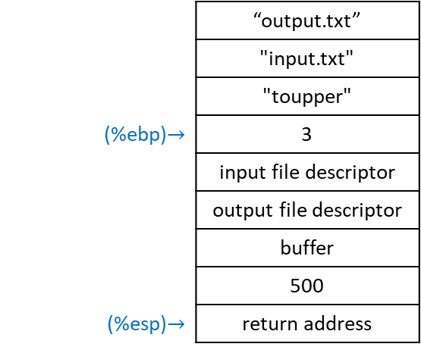
ToUpper continue_read_loop: convert_to_upper()
convert_loop:
  movb (%eax,%edi,1), %cl # get current byte by starting at %eax
  # and go %edi bytes forward, take that
  # value and put it in %cl
  # check if ‘a’ ≤ value ≤ ‘z’
  cmpb $LOWERCASE_A, %cl # smaller than ‘a’ isn’t lowercase
  jl next_byte # so jump to next byte
  cmpb $LOWERCASE_Z, %cl # greater than ‘z’ isn’t lowercase
  jg next_byte # so jump to next byte
  # otherwise convert byte to uppercase
  addb $UPPER_CONVERSION, %cl # add -32 to %cl
  movb %cl, (%eax,%edi,1) # and store it back
next_byte:
  incl %edi # next byte
  cmpl %edi, %ebx # are we at the end of the buffer?
  jne convert_loop # if not at the end, convert next value
end_convert_loop: # if at the end, finish (label not
# really necessary)
  movl %ebp, %esp # restore stack pointer
  popl %ebp # restore base pointer
  ret # popl %eip
 | “output.txt”
 | "input.txt"
 | "toupper"
(%ebp)$→$ | 3
 | input file descriptor
 | output file descriptor
 | buffer
 | 500
(%esp)$→$ | return address
EAX = buffer
EBX = 500
ECX = buffer
EDX = 500
EIP = start of convert function
EDI = 500
CL = X
EBP = old EBP
%eax
$$↓$$
H F q B … N e x
0 1 2 3 … 497 498 499

Slide 109
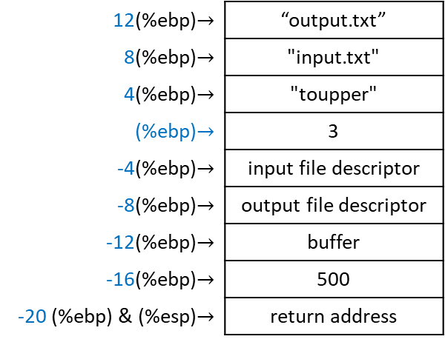
ToUpper continue_read_loop: convert_to_upper()
convert_loop:
  movb (%eax,%edi,1), %cl # get current byte by starting at %eax
  # and go %edi bytes forward, take that
  # value and put it in %cl
  # check if ‘a’ ≤ value ≤ ‘z’
  cmpb $LOWERCASE_A, %cl # smaller than ‘a’ isn’t lowercase
  jl next_byte # so jump to next byte
  cmpb $LOWERCASE_Z, %cl # greater than ‘z’ isn’t lowercase
  jg next_byte # so jump to next byte
  # otherwise convert byte to uppercase
  addb $UPPER_CONVERSION, %cl # add -32 to %cl
  movb %cl, (%eax,%edi,1) # and store it back
next_byte:
  incl %edi # next byte
  cmpl %edi, %ebx # are we at the end of the buffer?
  jne convert_loop # if not at the end, convert next value
end_convert_loop: # if at the end, finish (label not
# really necessary)
  movl %ebp, %esp # restore stack pointer
  popl %ebp # restore base pointer
  ret # popl %eip
12(%ebp)$→$ | “output.txt”
8(%ebp)$→$ | "input.txt"
4(%ebp)$→$ | "toupper"
(%ebp)$→$ | 3
-4(%ebp)$→$ | input file descriptor
-8(%ebp)$→$ | output file descriptor
-12(%ebp)$→$ | buffer
-16(%ebp)$→$ | 500
-20 (%ebp) & (%esp)$→$ | return address
EAX = buffer
EBX = 500
ECX = buffer
EDX = 500
EIP = start of convert function
EDI = 500
CL = X
EBP = old EBP
%eax
$$↓$$
H F q B … N e x
0 1 2 3 … 497 498 499

Slide 110
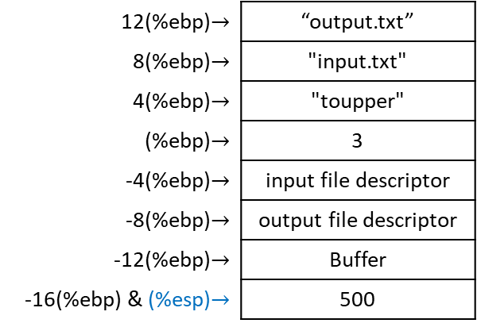
ToUpper continue_read_loop: convert_to_upper()
convert_loop:
  movb (%eax,%edi,1), %cl # get current byte by starting at %eax
  # and go %edi bytes forward, take that
  # value and put it in %cl
  # check if ‘a’ ≤ value ≤ ‘z’
  cmpb $LOWERCASE_A, %cl # smaller than ‘a’ isn’t lowercase
  jl next_byte # so jump to next byte
  cmpb $LOWERCASE_Z, %cl # greater than ‘z’ isn’t lowercase
  jg next_byte # so jump to next byte
  # otherwise convert byte to uppercase
  addb $UPPER_CONVERSION, %cl # add -32 to %cl
  movb %cl, (%eax,%edi,1) # and store it back
next_byte:
  incl %edi # next byte
  cmpl %edi, %ebx # are we at the end of the buffer?
  jne convert_loop # if not at the end, convert next value
end_convert_loop: # if at the end, finish (label not
# really necessary)
  movl %ebp, %esp # restore stack pointer
  popl %ebp # restore base pointer
  ret # popl %eip
12(%ebp)$→$ | “output.txt”
8(%ebp)$→$ | "input.txt"
4(%ebp)$→$ | "toupper"
(%ebp)$→$ | 3
-4(%ebp)$→$ | input file descriptor
-8(%ebp)$→$ | output file descriptor
-12(%ebp)$→$ | Buffer
-16(%ebp) & (%esp)$→$ | 500
EAX = buffer
EBX = 500
ECX = buffer
EDX = 500
EIP = return address
EDI = 500
CL = X
EBP = old EBP
%eax
$$↓$$
Changes already in buffer, no need to return anything.
H F q B … N e x
0 1 2 3 … 497 498 499

Slide 111
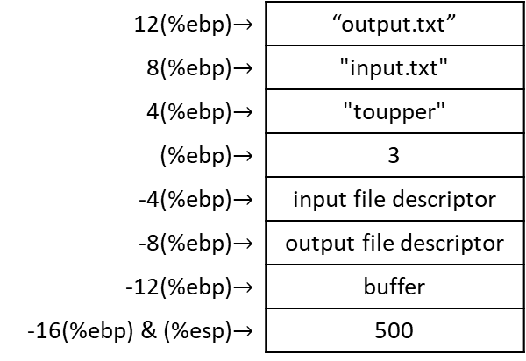
ToUpper main loop = read_loop_begin + continue_read_loop + end_loop
continue_read_loop:
  ### CONVERT THE BLOCK TO UPPER CASE ###
  pushl $BUFFER_DATA # location of buffer
  pushl %eax # size of buffer
  call convert_to_upper
  popl %eax # restore %eax register with
  # size of buffer
  addl $4, %esp # restore %esp
  ### WRITE THE BLOCK OUT TO THE OUTPUT FILE ###
  movl %eax, %edx # size of buffer
  movl $SYS_WRITE, %eax # issue a write system call
  movl ST_FD_OUT(%ebp), %ebx # file to write into
  movl $BUFFER_DATA, %ecx # location of buffer
  int $LINUX_SYSCALL
  ### CONTINUE THE LOOP ###
  jmp read_loop_begin
12(%ebp)$→$ | “output.txt”
8(%ebp)$→$ | "input.txt"
4(%ebp)$→$ | "toupper"
(%ebp)$→$ | 3
-4(%ebp)$→$ | input file descriptor
-8(%ebp)$→$ | output file descriptor
-12(%ebp)$→$ | buffer
-16(%ebp) & (%esp)$→$ | 500
EAX = buffer
EBX = 500
ECX = buffer
EDX = 500
EIP = return address
EDI = 500
CL = X
EBP = old EBP

Slide 112
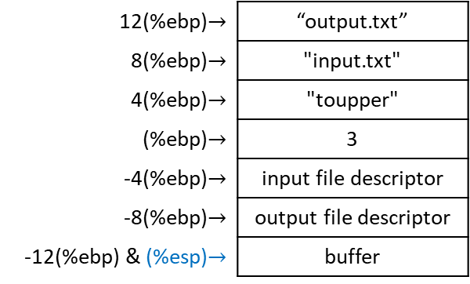
ToUpper main loop = read_loop_begin + continue_read_loop + end_loop
continue_read_loop:
  ### CONVERT THE BLOCK TO UPPER CASE ###
  pushl $BUFFER_DATA # location of buffer
  pushl %eax # size of buffer
  call convert_to_upper
  popl %eax # restore %eax register with
  # size of buffer
  addl $4, %esp # restore %esp
  ### WRITE THE BLOCK OUT TO THE OUTPUT FILE ###
  movl %eax, %edx # size of buffer
  movl $SYS_WRITE, %eax # issue a write system call
  movl ST_FD_OUT(%ebp), %ebx # file to write into
  movl $BUFFER_DATA, %ecx # location of buffer
  int $LINUX_SYSCALL
  ### CONTINUE THE LOOP ###
  jmp read_loop_begin
12(%ebp)$→$ | “output.txt”
8(%ebp)$→$ | "input.txt"
4(%ebp)$→$ | "toupper"
(%ebp)$→$ | 3
-4(%ebp)$→$ | input file descriptor
-8(%ebp)$→$ | output file descriptor
-12(%ebp) & (%esp)$→$ | buffer
EAX = 500
EBX = 500
ECX = buffer
EDX = 500
EIP = return address
EDI = 500
CL = X
EBP = old EBP

Slide 113
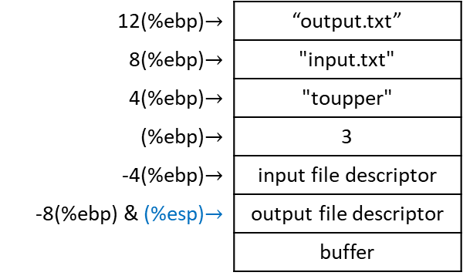
ToUpper main loop = read_loop_begin + continue_read_loop + end_loop
continue_read_loop:
  ### CONVERT THE BLOCK TO UPPER CASE ###
  pushl $BUFFER_DATA # location of buffer
  pushl %eax # size of buffer
  call convert_to_upper
  popl %eax # restore %eax register with
  # size of buffer
  addl $4, %esp # restore %esp
  ### WRITE THE BLOCK OUT TO THE OUTPUT FILE ###
  movl %eax, %edx # size of buffer
  movl $SYS_WRITE, %eax # issue a write system call
  movl ST_FD_OUT(%ebp), %ebx # file to write into
  movl $BUFFER_DATA, %ecx # location of buffer
  int $LINUX_SYSCALL
  ### CONTINUE THE LOOP ###
  jmp read_loop_begin
12(%ebp)$→$ | “output.txt”
8(%ebp)$→$ | "input.txt"
4(%ebp)$→$ | "toupper"
(%ebp)$→$ | 3
-4(%ebp)$→$ | input file descriptor
-8(%ebp) & (%esp)$→$ | output file descriptor
 | buffer
EAX = 500
EBX = 500
ECX = buffer
EDX = 500
EIP = return address
EDI = 500
CL = X
EBP = old EBP

Slide 114
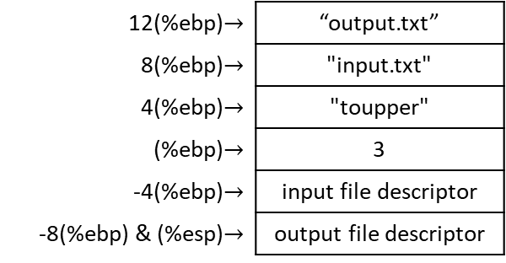
ToUpper main loop = read_loop_begin + continue_read_loop + end_loop
continue_read_loop:
  ### CONVERT THE BLOCK TO UPPER CASE ###
  pushl $BUFFER_DATA # location of buffer
  pushl %eax # size of buffer
  call convert_to_upper
  popl %eax # restore %eax register with
  # size of buffer
  addl $4, %esp # restore %esp
  ### WRITE THE BLOCK OUT TO THE OUTPUT FILE ###
  movl %eax, %edx # size of buffer
  movl $SYS_WRITE, %eax # issue a write system call
  movl ST_FD_OUT(%ebp), %ebx # file to write into
  movl $BUFFER_DATA, %ecx # location of buffer
  int $LINUX_SYSCALL
  ### CONTINUE THE LOOP ###
  jmp read_loop_begin
12(%ebp)$→$ | “output.txt”
8(%ebp)$→$ | "input.txt"
4(%ebp)$→$ | "toupper"
(%ebp)$→$ | 3
-4(%ebp)$→$ | input file descriptor
-8(%ebp) & (%esp)$→$ | output file descriptor
EAX = 500
EBX = 500
ECX = buffer
EDX = 500
EIP = return address
EDI = 500
CL = X
EBP = old EBP

Slide 115
ToUpper main loop = read_loop_begin + continue_read_loop + end_loop
continue_read_loop:
  ### CONVERT THE BLOCK TO UPPER CASE ###
  pushl $BUFFER_DATA # location of buffer
  pushl %eax # size of buffer
  call convert_to_upper
  popl %eax # restore %eax register with
  # size of buffer
  addl $4, %esp # restore %esp
  ### WRITE THE BLOCK OUT TO THE OUTPUT FILE ###
  movl %eax, %edx # size of buffer
  movl $SYS_WRITE, %eax # issue a write system call
  movl ST_FD_OUT(%ebp), %ebx # file to write into
  movl $BUFFER_DATA, %ecx # location of buffer
  int $LINUX_SYSCALL
  ### CONTINUE THE LOOP ###
  jmp read_loop_begin
12(%ebp)$→$ | “output.txt”
8(%ebp)$→$ | "input.txt"
4(%ebp)$→$ | "toupper"
(%ebp)$→$ | 3
-4(%ebp)$→$ | input file descriptor
-8(%ebp) & (%esp)$→$ | output file descriptor
.equ SYS_WRITE, 4
EAX = 4
EBX = 500
ECX = buffer
EDX = 500
EIP = return address
EDI = 500
CL = X
EBP = old EBP

Slide 116

ToUpper main loop = read_loop_begin + continue_read_loop + end_loop
continue_read_loop:
  ### CONVERT THE BLOCK TO UPPER CASE ###
  pushl $BUFFER_DATA # location of buffer
  pushl %eax # size of buffer
  call convert_to_upper
  popl %eax # restore %eax register with
  # size of buffer
  addl $4, %esp # restore %esp
  ### WRITE THE BLOCK OUT TO THE OUTPUT FILE ###
  movl %eax, %edx # size of buffer
  movl $SYS_WRITE, %eax # issue a write system call
  movl ST_FD_OUT(%ebp), %ebx # file to write into
  movl $BUFFER_DATA, %ecx # location of buffer
  int $LINUX_SYSCALL
  ### CONTINUE THE LOOP ###
  jmp read_loop_begin
12(%ebp)$→$ | “output.txt”
8(%ebp)$→$ | "input.txt"
4(%ebp)$→$ | "toupper"
(%ebp)$→$ | 3
-4(%ebp)$→$ | input file descriptor
-8(%ebp) & (%esp)$→$ | output file descriptor
.equ ST_FD_OUT, -8
EAX = 4
EBX = output file descriptor
ECX = buffer
EDX = 500
EIP = return address
EDI = 500
CL = X
EBP = old EBP

Slide 117
ToUpper main loop = read_loop_begin + continue_read_loop + end_loop
continue_read_loop:
  ### CONVERT THE BLOCK TO UPPER CASE ###
  pushl $BUFFER_DATA # location of buffer
  pushl %eax # size of buffer
  call convert_to_upper
  popl %eax # restore %eax register with
  # size of buffer
  addl $4, %esp # restore %esp
  ### WRITE THE BLOCK OUT TO THE OUTPUT FILE ###
  movl %eax, %edx # size of buffer
  movl $SYS_WRITE, %eax # issue a write system call
  movl ST_FD_OUT(%ebp), %ebx # file to write into
  movl $BUFFER_DATA, %ecx # location of buffer
  int $LINUX_SYSCALL
  ### CONTINUE THE LOOP ###
  jmp read_loop_begin
12(%ebp)$→$ | “output.txt”
8(%ebp)$→$ | "input.txt"
4(%ebp)$→$ | "toupper"
(%ebp)$→$ | 3
-4(%ebp)$→$ | input file descriptor
-8(%ebp) & (%esp)$→$ | output file descriptor
.lcomm BUFFER_DATA, BUFFER_SIZE
EAX = 4
EBX = output file descriptor
ECX = buffer
EDX = 500
EIP = return address
EDI = 500
CL = X
EBP = old EBP

Slide 118
ToUpper main loop = read_loop_begin + continue_read_loop + end_loop
continue_read_loop:
  ### CONVERT THE BLOCK TO UPPER CASE ###
  pushl $BUFFER_DATA # location of buffer
  pushl %eax # size of buffer
  call convert_to_upper
  popl %eax # restore %eax register with
  # size of buffer
  addl $4, %esp # restore %esp
  ### WRITE THE BLOCK OUT TO THE OUTPUT FILE ###
  movl %eax, %edx # size of buffer
  movl $SYS_WRITE, %eax # issue a write system call
  movl ST_FD_OUT(%ebp), %ebx # file to write into
  movl $BUFFER_DATA, %ecx # location of buffer
  int $LINUX_SYSCALL
  ### CONTINUE THE LOOP ###
  jmp read_loop_begin
12(%ebp)$→$ | “output.txt”
8(%ebp)$→$ | "input.txt"
4(%ebp)$→$ | "toupper"
(%ebp)$→$ | 3
-4(%ebp)$→$ | input file descriptor
-8(%ebp) & (%esp)$→$ | output file descriptor
.equ LINUX_SYSCALL, 0x80
EAX = 4
EBX = output file descriptor
ECX = buffer
EDX = 500
EIP = return address
EDI = 500
CL = X
EBP = old EBP

Slide 119
ToUpper main loop = read_loop_begin + continue_read_loop + end_loop
continue_read_loop:
  ### CONVERT THE BLOCK TO UPPER CASE ###
  pushl $BUFFER_DATA # location of buffer
  pushl %eax # size of buffer
  call convert_to_upper
  popl %eax # restore %eax register with
  # size of buffer
  addl $4, %esp # restore %esp
  ### WRITE THE BLOCK OUT TO THE OUTPUT FILE ###
  movl %eax, %edx # size of buffer
  movl $SYS_WRITE, %eax # issue a write system call
  movl ST_FD_OUT(%ebp), %ebx # file to write into
  movl $BUFFER_DATA, %ecx # location of buffer
  int $LINUX_SYSCALL
  ### CONTINUE THE LOOP ###
  jmp read_loop_begin
12(%ebp)$→$ | “output.txt”
8(%ebp)$→$ | "input.txt"
4(%ebp)$→$ | "toupper"
(%ebp)$→$ | 3
-4(%ebp)$→$ | input file descriptor
-8(%ebp) & (%esp)$→$ | output file descriptor
EAX = 4
EBX = output file descriptor
ECX = buffer
EDX = 500
EIP = return address
EDI = 500
CL = X
EBP = old EBP

Slide 120
ToUpper main loop = read_loop_begin + continue_read_loop + end_loop
  ### BEGIN MAIN LOOP ###
read_loop_begin:
  ### READ IN A BLOCK FROM THE INPUT FILE ###
  movl $SYS_READ, %eax # read input file (syscall 3)
  movl ST_FD_IN(%ebp), %ebx # get input file descriptor
  movl $BUFFER_DATA, %ecx # location to read from
  movl $BUFFER_SIZE, %edx # size of buffer
  int $LINUX_SYSCALL # size of buffer read is
  # returned in %eax, returns
  # number of bytes actually read
  # or end-of-file (the number 0)
  ### EXIT IF WE’VE REACHED THE END ###
  cmpl $END_OF_FILE, %eax # check %eax for end-of-file marker
  jle end_loop # if found, or on error, go to the end
12(%ebp)$→$ | “output.txt”
8(%ebp)$→$ | "input.txt"
4(%ebp)$→$ | "toupper"
(%ebp)$→$ | 3
-4(%ebp)$→$ | input file descriptor
-8(%ebp) & (%esp)$→$ | output file descriptor
.equ SYS_READ, 3
EAX = 3
EBX = output file descriptor
ECX = buffer
EDX = 500
EIP = return address
EDI = 500
CL = X
EBP = old EBP

Slide 121

ToUpper main loop = read_loop_begin + continue_read_loop + end_loop
  ### BEGIN MAIN LOOP ###
read_loop_begin:
  ### READ IN A BLOCK FROM THE INPUT FILE ###
  movl $SYS_READ, %eax # read input file (syscall 3)
  movl ST_FD_IN(%ebp), %ebx # get input file descriptor
  movl $BUFFER_DATA, %ecx # location to read from
  movl $BUFFER_SIZE, %edx # size of buffer
  int $LINUX_SYSCALL # size of buffer read is
  # returned in %eax, returns
  # number of bytes actually read
  # or end-of-file (the number 0)
  ### EXIT IF WE’VE REACHED THE END ###
  cmpl $END_OF_FILE, %eax # check %eax for end-of-file marker
  jle end_loop # if found, or on error, go to the end
12(%ebp)$→$ | “output.txt”
8(%ebp)$→$ | "input.txt"
4(%ebp)$→$ | "toupper"
(%ebp)$→$ | 3
-4(%ebp)$→$ | input file descriptor
-8(%ebp) & (%esp)$→$ | output file descriptor
.equ ST_FD_IN, -4
EAX = 3
EBX = input file descriptor
ECX = buffer
EDX = 500
EIP = return address
EDI = 500
CL = X
EBP = old EBP

Slide 122
ToUpper main loop = read_loop_begin + continue_read_loop + end_loop
  ### BEGIN MAIN LOOP ###
read_loop_begin:
  ### READ IN A BLOCK FROM THE INPUT FILE ###
  movl $SYS_READ, %eax # read input file (syscall 3)
  movl ST_FD_IN(%ebp), %ebx # get input file descriptor
  movl $BUFFER_DATA, %ecx # location to read from
  movl $BUFFER_SIZE, %edx # size of buffer
  int $LINUX_SYSCALL # size of buffer read is
  # returned in %eax, returns
  # number of bytes actually read
  # or end-of-file (the number 0)
  ### EXIT IF WE’VE REACHED THE END ###
  cmpl $END_OF_FILE, %eax # check %eax for end-of-file marker
  jle end_loop # if found, or on error, go to the end
12(%ebp)$→$ | “output.txt”
8(%ebp)$→$ | "input.txt"
4(%ebp)$→$ | "toupper"
(%ebp)$→$ | 3
-4(%ebp)$→$ | input file descriptor
-8(%ebp) & (%esp)$→$ | output file descriptor
.lcomm BUFFER_DATA, BUFFER_SIZE
EAX = 3
EBX = input file descriptor
ECX = buffer
EDX = 500
EIP = return address
EDI = 500
CL = X
EBP = old EBP

Slide 123
ToUpper main loop = read_loop_begin + continue_read_loop + end_loop
  ### BEGIN MAIN LOOP ###
read_loop_begin:
  ### READ IN A BLOCK FROM THE INPUT FILE ###
  movl $SYS_READ, %eax # read input file (syscall 3)
  movl ST_FD_IN(%ebp), %ebx # get input file descriptor
  movl $BUFFER_DATA, %ecx # location to read from
  movl $BUFFER_SIZE, %edx # size of buffer
  int $LINUX_SYSCALL # size of buffer read is
  # returned in %eax, returns
  # number of bytes actually read
  # or end-of-file (the number 0)
  ### EXIT IF WE’VE REACHED THE END ###
  cmpl $END_OF_FILE, %eax # check %eax for end-of-file marker
  jle end_loop # if found, or on error, go to the end
12(%ebp)$→$ | “output.txt”
8(%ebp)$→$ | "input.txt"
4(%ebp)$→$ | "toupper"
(%ebp)$→$ | 3
-4(%ebp)$→$ | input file descriptor
-8(%ebp) & (%esp)$→$ | output file descriptor
.equ BUFFER_SIZE, 500
EAX = 3
EBX = input file descriptor
ECX = buffer
EDX = 500
EIP = return address
EDI = 500
CL = X
EBP = old EBP

Slide 124
ToUpper main loop = read_loop_begin + continue_read_loop + end_loop
  ### BEGIN MAIN LOOP ###
read_loop_begin:
  ### READ IN A BLOCK FROM THE INPUT FILE ###
  movl $SYS_READ, %eax # read input file (syscall 3)
  movl ST_FD_IN(%ebp), %ebx # get input file descriptor
  movl $BUFFER_DATA, %ecx # location to read from
  movl $BUFFER_SIZE, %edx # size of buffer
  int $LINUX_SYSCALL # size of buffer read is
  # returned in %eax, returns
  # number of bytes actually read
  # or end-of-file (the number 0)
  ### EXIT IF WE’VE REACHED THE END ###
  cmpl $END_OF_FILE, %eax # check %eax for end-of-file marker
  jle end_loop # if found, or on error, go to the end
12(%ebp)$→$ | “output.txt”
8(%ebp)$→$ | "input.txt"
4(%ebp)$→$ | "toupper"
(%ebp)$→$ | 3
-4(%ebp)$→$ | input file descriptor
-8(%ebp) & (%esp)$→$ | output file descriptor
.equ LINUX_SYSCALL, 0x80
EAX = 0
EBX = input file descriptor
ECX = buffer
EDX = 500
EIP = return address
EDI = 500
CL = X
EBP = old EBP

Slide 125

ToUpper main loop = read_loop_begin + continue_read_loop + end_loop
  ### BEGIN MAIN LOOP ###
read_loop_begin:
  ### READ IN A BLOCK FROM THE INPUT FILE ###
  movl $SYS_READ, %eax # read input file (syscall 3)
  movl ST_FD_IN(%ebp), %ebx # get input file descriptor
  movl $BUFFER_DATA, %ecx # location to read from
  movl $BUFFER_SIZE, %edx # size of buffer
  int $LINUX_SYSCALL # size of buffer read is
  # returned in %eax, returns
  # number of bytes actually read
  # or end-of-file (the number 0)
  ### EXIT IF WE’VE REACHED THE END ###
  cmpl $END_OF_FILE, %eax # check %eax for end-of-file marker
  jle end_loop # if found, or on error, go to the end
12(%ebp)$→$ | “output.txt”
8(%ebp)$→$ | "input.txt"
4(%ebp)$→$ | "toupper"
(%ebp)$→$ | 3
-4(%ebp)$→$ | input file descriptor
-8(%ebp) & (%esp)$→$ | output file descriptor
.equ END_OF_FILE, 0
EAX = 0 ≤ 0 $? →$ true
EBX = input file descriptor
ECX = buffer
EDX = 500
EIP = return address
EDI = 500
CL = X
EBP = old EBP

Slide 126
ToUpper main loop = read_loop_begin + continue_read_loop + end_loop
  ### BEGIN MAIN LOOP ###
read_loop_begin:
  ### READ IN A BLOCK FROM THE INPUT FILE ###
  movl $SYS_READ, %eax # read input file (syscall 3)
  movl ST_FD_IN(%ebp), %ebx # get input file descriptor
  movl $BUFFER_DATA, %ecx # location to read from
  movl $BUFFER_SIZE, %edx # size of buffer
  int $LINUX_SYSCALL # size of buffer read is
  # returned in %eax, returns
  # number of bytes actually read
  # or end-of-file (the number 0)
  ### EXIT IF WE’VE REACHED THE END ###
  cmpl $END_OF_FILE, %eax # check %eax for end-of-file marker
  jle end_loop # if found, or on error, go to the end
12(%ebp)$→$ | “output.txt”
8(%ebp)$→$ | "input.txt"
4(%ebp)$→$ | "toupper"
(%ebp)$→$ | 3
-4(%ebp)$→$ | input file descriptor
-8(%ebp) & (%esp)$→$ | output file descriptor
.equ END_OF_FILE, 0
EAX = 0
EBX = input file descriptor
ECX = buffer
EDX = 500
EIP = return address
EDI = 500
CL = X
EBP = old EBP

Slide 127
ToUpper main loop = read_loop_begin + continue_read_loop + end_loop
end_loop:
  ### CLOSE THE FILES ###
  movl $SYS_CLOSE, %eax # sets up a close system call,
  movl ST_FD_OUT(%ebp), %ebx # which takes in the file descriptor
  # to close
  int $LINUX_SYSCALL # executes system call
  movl $SYS_CLOSE, %eax # sets up a close system call,
  movl ST_FD_IN(%ebp), %ebx # which takes in the file descriptor
  # to close
  int $LINUX_SYSCALL # executes system call
  ### EXIT ###
  movl $SYS_EXIT, %eax # sets up an exit system call
  movl $0, %ebx # exit status 0
  int $LINUX_SYSCALL # executes system call
12(%ebp)$→$ | “output.txt”
8(%ebp)$→$ | "input.txt"
4(%ebp)$→$ | "toupper"
(%ebp)$→$ | 3
-4(%ebp)$→$ | input file descriptor
-8(%ebp) & (%esp)$→$ | output file descriptor
.equ SYS_CLOSE, 6
EAX = 6
EBX = input file descriptor
ECX = buffer
EDX = 500
EIP = return address
EDI = 500
CL = X
EBP = old EBP

Slide 128
ToUpper main loop = read_loop_begin + continue_read_loop + end_loop
end_loop:
  ### CLOSE THE FILES ###
  movl $SYS_CLOSE, %eax # sets up a close system call,
  movl ST_FD_OUT(%ebp), %ebx # which takes in the file descriptor
  # to close
  int $LINUX_SYSCALL # executes system call
  movl $SYS_CLOSE, %eax # sets up a close system call,
  movl ST_FD_IN(%ebp), %ebx # which takes in the file descriptor
  # to close
  int $LINUX_SYSCALL # executes system call
  ### EXIT ###
  movl $SYS_EXIT, %eax # sets up an exit system call
  movl $0, %ebx # exit status 0
  int $LINUX_SYSCALL # executes system call
12(%ebp)$→$ | “output.txt”
8(%ebp)$→$ | "input.txt"
4(%ebp)$→$ | "toupper"
(%ebp)$→$ | 3
-4(%ebp)$→$ | input file descriptor
-8(%ebp) & (%esp)$→$ | output file descriptor
.equ ST_FD_OUT, -8
EAX = 6
EBX = output file descriptor
ECX = buffer
EDX = 500
EIP = return address
EDI = 500
CL = X
EBP = old EBP

Slide 129
ToUpper main loop = read_loop_begin + continue_read_loop + end_loop
end_loop:
  ### CLOSE THE FILES ###
  movl $SYS_CLOSE, %eax # sets up a close system call,
  movl ST_FD_OUT(%ebp), %ebx # which takes in the file descriptor
  # to close
  int $LINUX_SYSCALL # executes system call
  movl $SYS_CLOSE, %eax # sets up a close system call,
  movl ST_FD_IN(%ebp), %ebx # which takes in the file descriptor
  # to close
  int $LINUX_SYSCALL # executes system call
  ### EXIT ###
  movl $SYS_EXIT, %eax # sets up an exit system call
  movl $0, %ebx # exit status 0
  int $LINUX_SYSCALL # executes system call
12(%ebp)$→$ | “output.txt”
8(%ebp)$→$ | "input.txt"
4(%ebp)$→$ | "toupper"
(%ebp)$→$ | 3
-4(%ebp)$→$ | input file descriptor
-8(%ebp) & (%esp)$→$ | output file descriptor
.equ LINUX_SYSCALL, 0x80
EAX = 6
EBX = output file descriptor
ECX = buffer
EDX = 500
EIP = return address
EDI = 500
CL = X
EBP = old EBP

Slide 130
ToUpper main loop = read_loop_begin + continue_read_loop + end_loop
end_loop:
  ### CLOSE THE FILES ###
  movl $SYS_CLOSE, %eax # sets up a close system call,
  movl ST_FD_OUT(%ebp), %ebx # which takes in the file descriptor
  # to close
  int $LINUX_SYSCALL # executes system call
  movl $SYS_CLOSE, %eax # sets up a close system call,
  movl ST_FD_IN(%ebp), %ebx # which takes in the file descriptor
  # to close
  int $LINUX_SYSCALL # executes system call
  ### EXIT ###
  movl $SYS_EXIT, %eax # sets up an exit system call
  movl $0, %ebx # exit status 0
  int $LINUX_SYSCALL # executes system call
12(%ebp)$→$ | “output.txt”
8(%ebp)$→$ | "input.txt"
4(%ebp)$→$ | "toupper"
(%ebp)$→$ | 3
-4(%ebp)$→$ | input file descriptor
-8(%ebp) & (%esp)$→$ | output file descriptor
.equ SYS_CLOSE, 6
EAX = 6
EBX = output file descriptor
ECX = buffer
EDX = 500
EIP = return address
EDI = 500
CL = X
EBP = old EBP

Slide 131
ToUpper main loop = read_loop_begin + continue_read_loop + end_loop
end_loop:
  ### CLOSE THE FILES ###
  movl $SYS_CLOSE, %eax # sets up a close system call,
  movl ST_FD_OUT(%ebp), %ebx # which takes in the file descriptor
  # to close
  int $LINUX_SYSCALL # executes system call
  movl $SYS_CLOSE, %eax # sets up a close system call,
  movl ST_FD_IN(%ebp), %ebx # which takes in the file descriptor
  # to close
  int $LINUX_SYSCALL # executes system call
  ### EXIT ###
  movl $SYS_EXIT, %eax # sets up an exit system call
  movl $0, %ebx # exit status 0
  int $LINUX_SYSCALL # executes system call
12(%ebp)$→$ | “output.txt”
8(%ebp)$→$ | "input.txt"
4(%ebp)$→$ | "toupper"
(%ebp)$→$ | 3
-4(%ebp)$→$ | input file descriptor
-8(%ebp) & (%esp)$→$ | output file descriptor
.equ ST_FD_IN, -4
EAX = 6
EBX = input file descriptor
ECX = buffer
EDX = 500
EIP = return address
EDI = 500
CL = X
EBP = old EBP

Slide 132
ToUpper main loop = read_loop_begin + continue_read_loop + end_loop
end_loop:
  ### CLOSE THE FILES ###
  movl $SYS_CLOSE, %eax # sets up a close system call,
  movl ST_FD_OUT(%ebp), %ebx # which takes in the file descriptor
  # to close
  int $LINUX_SYSCALL # executes system call
  movl $SYS_CLOSE, %eax # sets up a close system call,
  movl ST_FD_IN(%ebp), %ebx # which takes in the file descriptor
  # to close
  int $LINUX_SYSCALL # executes system call
  ### EXIT ###
  movl $SYS_EXIT, %eax # sets up an exit system call
  movl $0, %ebx # exit status 0
  int $LINUX_SYSCALL # executes system call
12(%ebp)$→$ | “output.txt”
8(%ebp)$→$ | "input.txt"
4(%ebp)$→$ | "toupper"
(%ebp)$→$ | 3
-4(%ebp)$→$ | input file descriptor
-8(%ebp) & (%esp)$→$ | output file descriptor
.equ LINUX_SYSCALL, 0x80
EAX = 6
EBX = input file descriptor
ECX = buffer
EDX = 500
EIP = return address
EDI = 500
CL = X
EBP = old EBP

Slide 133
ToUpper main loop = read_loop_begin + continue_read_loop + end_loop
end_loop:
  ### CLOSE THE FILES ###
  movl $SYS_CLOSE, %eax # sets up a close system call,
  movl ST_FD_OUT(%ebp), %ebx # which takes in the file descriptor
  # to close
  int $LINUX_SYSCALL # executes system call
  movl $SYS_CLOSE, %eax # sets up a close system call,
  movl ST_FD_IN(%ebp), %ebx # which takes in the file descriptor
  # to close
  int $LINUX_SYSCALL # executes system call
  ### EXIT ###
  movl $SYS_EXIT, %eax # sets up an exit system call
  movl $0, %ebx # exit status 0
  int $LINUX_SYSCALL # executes system call
12(%ebp)$→$ | “output.txt”
8(%ebp)$→$ | "input.txt"
4(%ebp)$→$ | "toupper"
(%ebp)$→$ | 3
-4(%ebp)$→$ | input file descriptor
-8(%ebp) & (%esp)$→$ | output file descriptor
.equ SYS_EXIT, 1
EAX = 1
EBX = input file descriptor
ECX = buffer
EDX = 500
EIP = return address
EDI = 500
CL = X
EBP = old EBP

Slide 134
ToUpper main loop = read_loop_begin + continue_read_loop + end_loop
end_loop:
  ### CLOSE THE FILES ###
  movl $SYS_CLOSE, %eax # sets up a close system call,
  movl ST_FD_OUT(%ebp), %ebx # which takes in the file descriptor
  # to close
  int $LINUX_SYSCALL # executes system call
  movl $SYS_CLOSE, %eax # sets up a close system call,
  movl ST_FD_IN(%ebp), %ebx # which takes in the file descriptor
  # to close
  int $LINUX_SYSCALL # executes system call
  ### EXIT ###
  movl $SYS_EXIT, %eax # sets up an exit system call
  movl $0, %ebx # exit status 0
  int $LINUX_SYSCALL # executes system call
12(%ebp)$→$ | “output.txt”
8(%ebp)$→$ | "input.txt"
4(%ebp)$→$ | "toupper"
(%ebp)$→$ | 3
-4(%ebp)$→$ | input file descriptor
-8(%ebp) & (%esp)$→$ | output file descriptor
EAX = 1
EBX = 0
ECX = buffer
EDX = 500
EIP = return address
EDI = 500
CL = X
EBP = old EBP

Slide 135

ToUpper main loop = read_loop_begin + continue_read_loop + end_loop
end_loop:
  ### CLOSE THE FILES ###
  movl $SYS_CLOSE, %eax # sets up a close system call,
  movl ST_FD_OUT(%ebp), %ebx # which takes in the file descriptor
  # to close
  int $LINUX_SYSCALL # executes system call
  movl $SYS_CLOSE, %eax # sets up a close system call,
  movl ST_FD_IN(%ebp), %ebx # which takes in the file descriptor
  # to close
  int $LINUX_SYSCALL # executes system call
  ### EXIT ###
  movl $SYS_EXIT, %eax # sets up an exit system call
  movl $0, %ebx # exit status 0
  int $LINUX_SYSCALL # executes system call
12(%ebp)$→$ | “output.txt”
8(%ebp)$→$ | "input.txt"
4(%ebp)$→$ | "toupper"
(%ebp)$→$ | 3
-4(%ebp)$→$ | input file descriptor
-8(%ebp) & (%esp)$→$ | output file descriptor
.equ LINUX_SYSCALL, 0x80
EAX = 1
EBX = 0
ECX = buffer
EDX = 500
EIP = return address
EDI = 500
CL = X
EBP = old EBP
%eax
$$↓$$
Changes already in buffer, no need to return anything.
H F q B … N e x
0 1 2 3 … 497 498 499

Slide 136
ToUpper Answer
Changes already in output file, no need to return anything other than the exit status 0.
1 open
4 convert byte
2 open
buffer
input file
output file
500 bytes
222
3 read into buffer
0
5 read from buffer
STOP!
EAX = 1
EBX = 0
ECX = buffer
EDX = 500
EIP = return address
EDI = 500
CL = X
EBP = old EBP

Slide 137

ToUpper Assemble and link

Slide 138

ToUpper Input file

Slide 139

ToUpper Input file

Slide 140

ToUpper Output file

Slide 141

ToUpper Output file

